Slide 1
Intranasal Naloxone Administration: The power to save a life is under their nose
IMPD Southwest District Narcan Pilot Project

Slide 2
Objectives
Overview of the problem
Discuss the basics of opioids
  What are opioids?
    Illicit and Prescription
Educate on recognition of opioid overdose
Educate on Intranasal administration of Naloxone

Slide 3
The Opioid Overdose problem
THIS IS AN EPIDEMIC
Growing at an almost logarithmic rate
  Use
  Abuse
  Overdose deaths
No boundaries
  Age
  Gender
  Socioeconomic status

Slide 4
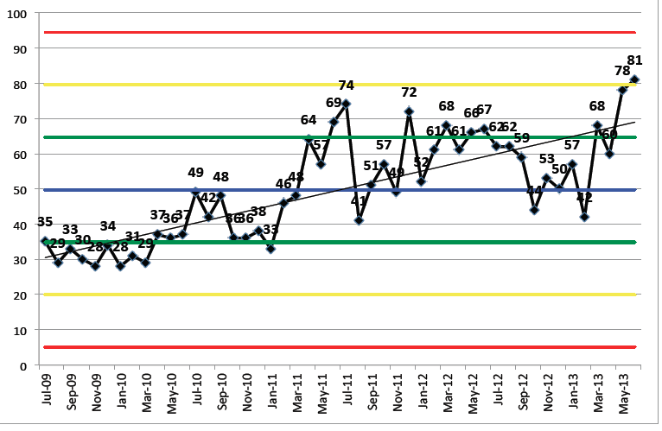
Narcan use by IEMS

Slide 5
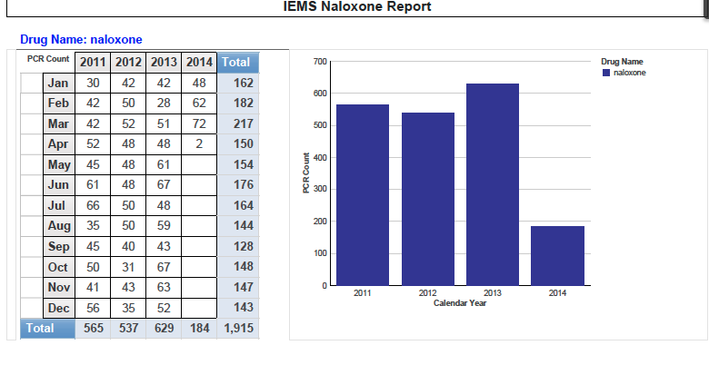
2014 Isn’t looking Good

Slide 6
Why is this
Prescription opiates are available everywhere
Getting harder to get a hold of
  New governmental regulations on prescribing
  More expensive
Often turning to heroin to get high

Slide 7
Law enforcement and Naloxone
Often first on scene
  Time is of the essence
Currently limited on what you can do
Intranasal Narcan administration by Law Enforcement
  Nassau County, NY
  Quincy, MA
  Others

Slide 8
Why Police?
Individual OD
Bystanders recognize something is wrong
Activate 911
Public Safety Response

Slide 9
Why Police?
Safe
Effective
Little to NO side effects
First step in combating deaths from overdose
  This is a true time sensitive emergency
  Any delay can lead to death

Slide 10
What are opiates
Synthetic or naturally occurring products derived from the poppy plant
They are classified as depressants
  CNS→ Slow mentation, alter level of consciousness
  Respiratory systems → Slow respirations, stop breathing
  Cardiovascular → Slow HR, Drop Blood pressure
But people take them to get high?
  Lower doses cause euphoria, loss of pain

Slide 11
How Do People Ingest?
Prescription
  Vicodin, Norco, Percocet, Percodan, Morphine, etc..
  Common pain relievers
    When taken in prescribed doses → predictive effects
    When taken in no prescribed doses → Variable
Illicit
  Heroin
  Injected, Snorted, Smoked
  VARIABLE effect
    Not predictable
  First time users can overdose

Slide 12
How Do They Kill?
Central Nervous System Depressant
“Slows” everything down
Slows or stops the vital organs of the body:
  Brain → Decreased LOC
    Decreased alertness
    Decreased Respiratory drive
  Brainstem
    Responsible for vital functions
    Take away the body’s desire to breath
    Drops HR, BP,

Slide 13
Decreased Respiratory Drive
How opiates kill
Body naturally wants to breath
This takes it away
Lose Consciousness → Lose drive to breath → Lose Oxygen → Go further out of consciousness → DEATH
All can be reversed in a timely manner

Slide 14
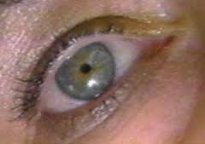
Picture of an overdose
Everything is slowed
Person often drifts out of consciousness
Unable to wake them up with even painful stimuli
Constricted pupils
Limp body
Abnormal respirations
Slowed respirations
No Respirations
Turn Blue, begin to “aspirate”
Death

Slide 15
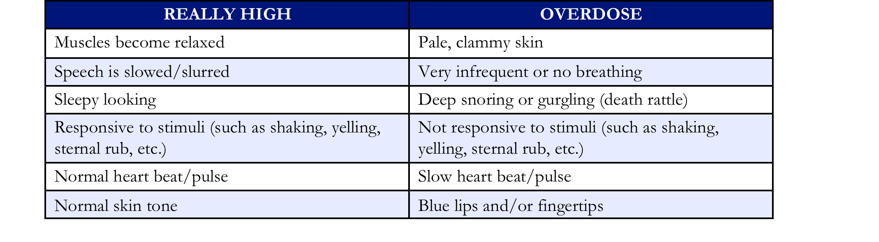
High vs. Overdose

Slide 16
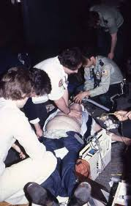
Once EMS Arrives
Can assist in breathing
If in cardiac arrest will begin treating accordingly
If not in cardiac arrest and unconscious will administer Naloxone
  Does not work if they have already gone into cardiac arrest
Almost 100% will need transportation to the hospital

Slide 17
When it is too late
Cardiac arrest
  Longer they are in cardiac arrest → Harder it is to get them back
    No matter the age
Effects of long term oxygen deficit
  Brain damage
    Very common after someone has overdosed
    Mild (forgetfulness) → Severe (inability to do normal activities)

Slide 18
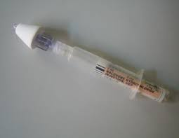
Naloxone/Narcan
Naloxone
  “Antidote” for opiates
    Onset up to 8 minutes
    Lasts 30-90 minutes
  Will reverse the effects
    Wake people up
    Stimulate breathing
Safe and effective
  Can be given through an IV
  Can be given intranasal
  Currently carried by paramedics

Slide 19
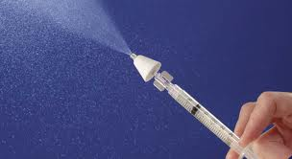
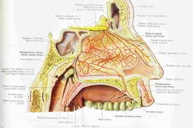
Intranasal naloxone
Given with the Mucosal Atomizer Device (MAD)
Creates a “mist of medication”
Absorbed through the nasal mucosa
They are not “breathing it in”

Slide 20
How are we going to give it?
Will be issued 2mg/ml vials
  Giving the whole thing
  ½ up one nostril, ½ up the other
Should start seeing results within minutes

Slide 21
What am I going to see
Respiratory rate increases
  No Breathing → Breathing
Color improves
  Blue → “Normal” color
Level of consciousness improves
GI issues
  Vomiting
  Diarrhea

Slide 22
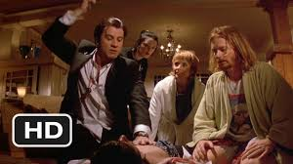
What about Combativeness?
Usually not seen in intranasal administration
Recent study showed #1 effect is confusion
  <3% became violent/combative
Our goal is to take them from dead to not dead
Goal: Safe transfer to EMS providers

Slide 23
But It’s not working
If they have been out for too long it may not work
If they have ingested other substances (EtOH, “downers”) it may not work
They may have ingested a really potent substance
Still no harm

Slide 24
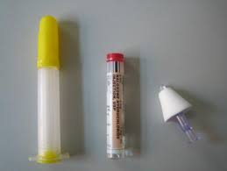
Procedure
Each officer will be administered 1 Intranasal narcan kit
Contains:
  2mg/2ml prefilled narcan syringe
  1 Mucosal Atomizer Device (MAD)
Storage
  Preferable on your person
  Can be held in your trauma kits

Slide 25
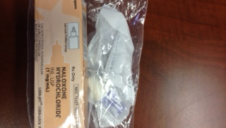
Pictures

Slide 26
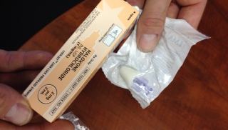

Slide 27
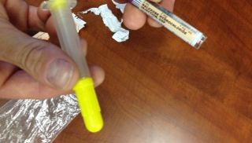

Slide 28
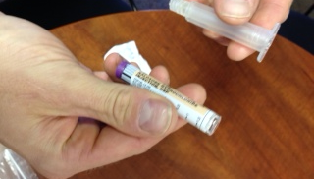

Slide 29
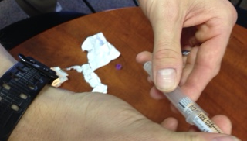

Slide 30
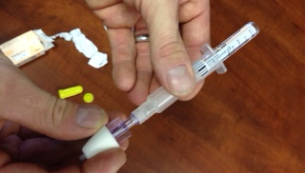

Slide 31
Administration
1st Identify overdose
  Does history and appearance seem consistent with opioid overdose
Ensure EMS is en route
Assess for responsiveness and breathing

Slide 32
Procedure Cont…
Responsiveness and breathing
Yes
NO
Monitor
Sternal Rub/Stimulate
Breathing
Yes
Observe
No
Ad mister Narcan

Slide 33
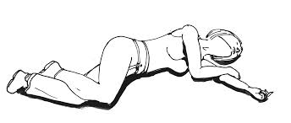
A different Way
Recognize opiate overdose
  Decreased LOC
  Decreased or no breathing
  In setting of likely opiate ingestion
Give sternal rub/stimulate
  If no response →Administer Narcan
Place in recovery position

Slide 34
The aftermath
100% will be transported to the hospital
  If patient refuses will have to ID
    Citing medical threat to self
Paperwork
  Brief information form
100% officer feedback within 48-72 hours

Slide 35
Legal issues
Lifeline bill 227 addendum
  Will provide protection to individuals who call for help in the event of an overdose
  Provide some protection from prosecution if attempts are made to help a victim
  Awaiting passage through house
  Hopefully address fears associated with calling for help
Signed March 2014
May see an increase in calls related to overdose

Slide 36
summary
Accidental deaths from opiate overdoses has become an EPIDEMIC
Early recognition and treatment of an overdose can help save a life
Police administration of narcan is a safe and effective means to save lives in the event of an overdose death
Unconscious + Not breathing + Right setting → IN Narcan (1ml up one nostril and 1ml up the other)

Slide 37
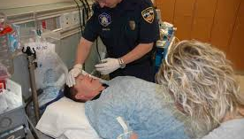
Questions?

