Slide 1
Overdose Response Training
Dave Morgan, RPh
Safe Prescribing Consultant, Norfolk District Attorney’s Office
Daniel Muse, MD
Brockton Hospital
Sgt. Brian Holmes & Sgt. Donna McNamara
Stoughton Police Department
Lt . Patrick Glynn
Quincy Police Department

Slide 3
Learning Objectives
Know how opioids work
Recognize an opioid overdose
Respond to opioid overdose
  Getting help
  Rescue breathing
  Administering naloxone

Slide 4
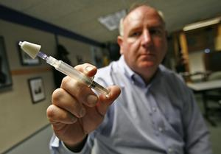
Police & Fire Programs in MA
Gloucester Police
Quincy Police
Revere Fire
Weymouth Fire
Saugus Fire
Nearly 300 rescues
Notes:
Image: http://commons.wikimedia.org/wiki/File:Police_and_Fire_Vehicles.jpg

Slide 5
What are opioids/opiates?
Opioids are sedative narcotics
They are used in medicine mainly to
relieve pain
Opioids repress the urge to breathe-
when someone is having an opioid
overdose, they stop breathing and
could die

Slide 6
The term opiate is often used as a synonym for opioid, but it is more. The term opiate is often used properly limited to the natural opium alkaloids and the semi-synthetics derived from them.
Opioids
Natural Opioids
opium
morphine
codeine
Semi-Synthetic Opioids
heroin
hydromorphone
hydrocodone
oxycodone
Fully Synthetic Opioids
fentanyl
methadone

Slide 7

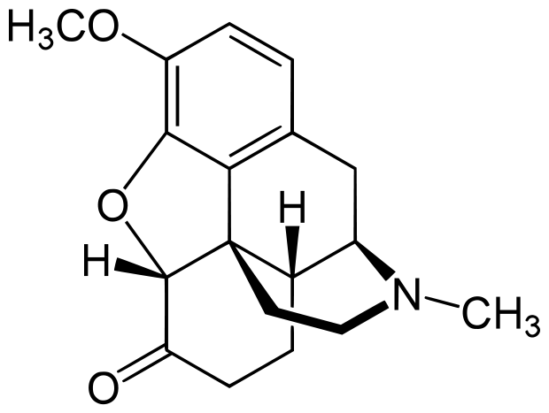
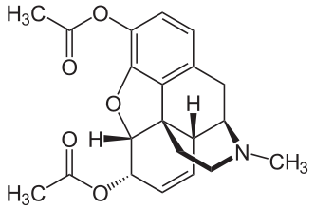
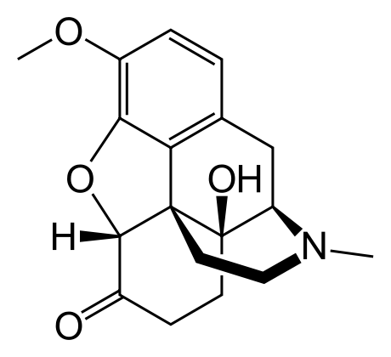
The Link Between Heroin
and Prescription Drugs
Hydrocodone
Heroin
Oxycodone

Slide 8
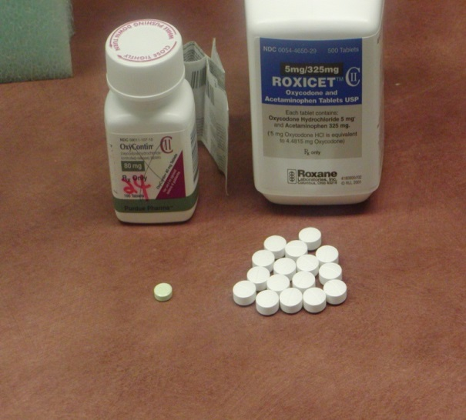
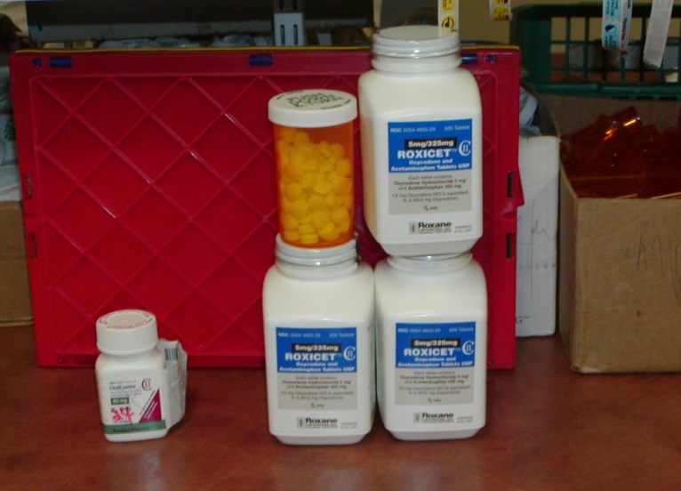
Scope of the Prescription
Drug Epidemic
1 equals 16
100 equals 1600 Percocets = $8000

Slide 9
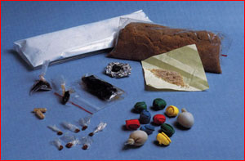
Most commonly used opioids
Heroin Hydrocodone
Codeine Oxycodone
Demerol Levorphanol
OxyContin Tylenol 3
Percocet Morphine
Percodan Vicodin
Codeine Demerol
Morphine Darvocet
Fentanyl Dilaudid
Methadone Opium
Opium Tylox

Slide 10
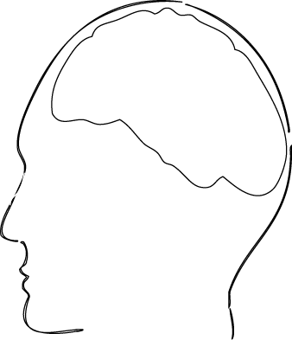



How do opioids affect breathing?
OVERDOSE
Opioid Receptors, brain
Opioid
Notes:
An overdose occurs when too much of an opioid, like heroin or Oxycontin, fits in too many receptors slowing and then stopping the breathing

Slide 11
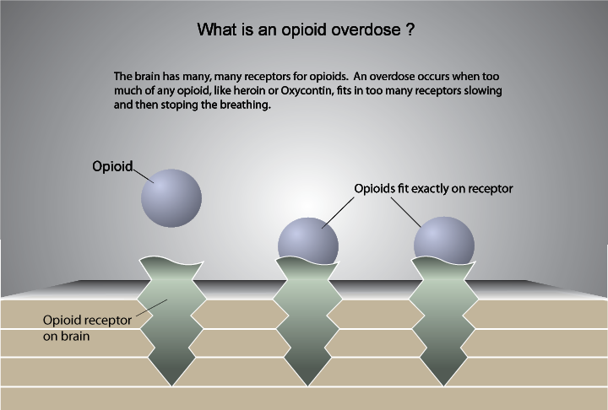
What is an opioid OD?

Slide 12
What puts people at risk
for ODs?
Mixing drugs- benzos, alcohol & cocaine especially
Changes in tolerance
Physical health
Previous experience of non-fatal overdose
Variation in strength and content of ‘street’ drugs

Slide 13
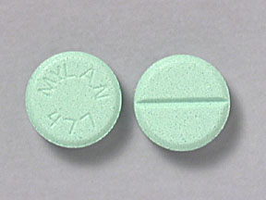
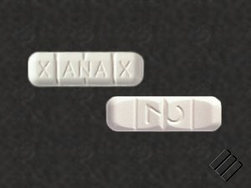
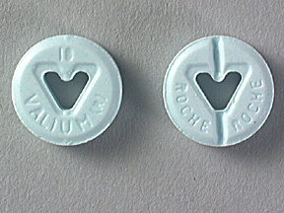
Mixing opioids with benzos
Combining opioids with benzodiazepines or alcohol leads to a worse outcome
Benzos are psychoactive drugs that have sedative, hypnotic, anxiolytic, anticonvulsant, muscle relaxant, and amnesic actions
The most commonly used benzos are: Klonopin, Valium, Ativan, Librium, and Xanax

Slide 14
What is Naloxone?
    Naloxone knocks the opiate off the opiate receptor- it does nothing other than blocking opiate receptors
    Temporarily takes away the “high,” giving the person the chance to breathe
    Naloxone works in 1 to 3 minutes and lasts 30 to 90 minutes
Notes:
14
14

Slide 15
What is NARCAN?
  Naloxone can neither be abused nor cause overdose, only contraindication is known sensitivity, which is very rare.
  Too much Naloxone can cause withdrawal symptoms such as:
  nausea/vomiting
  diarrhea
  chills
  muscle discomfort
  disorientation
  combativeness

Slide 16
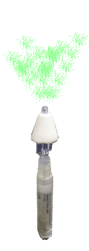

How does Naloxone effect overdose?
Restores breathing
Notes:
An overdose occurs when too much of an opioid, like heroin or Oxycontin, fits in too many receptors slowing and then stopping the breathing

Slide 17
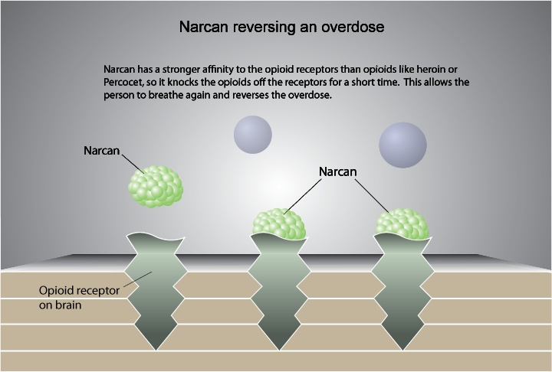
NALOXONE
reversing an overdose

Slide 18
Really high
Really high or overdose?
Overdose
Pupils pinned
Nodding, but arousable
  Responds to sternal rub
Speech is slurred
Sleepy, intoxicated, but breathing
  8 or more times per minute
Pupils pinned
Not arousable
  No response to sternal rub
Breathing slow or stopped
  Less than 8 times per minute
  May hear choking sounds or a gurgling/snoring noise
  Blue lips, blue fingertips
>> Stimulate and observe
>> Rescue breathe + give naloxone

Slide 19
What are the signs and
symptoms of an OD?
Blue skin tinge
Body very limp
Face very pale
Pulse (heartbeat) is slow
or not there at all
Throwing up
Passing out
Choking sounds or
a gurgling/snoring noise
Breathing is very slow,
irregular, or has stopped
REALLY HIGH | OVERDOSE
Muscles become relaxed | Deep snoring or gurgling (death rattle)
Speech is slowed/slurred | Very infrequent or no breathing
Sleepy looking | Pale, clammy skin
Nodding | Heavy nod
Will respond to stimulation like yelling, sternal rub, pinching, etc. | No response to stimulation
 | Slow heart beat/pulse

Slide 20
Environmental clues can help
Recognize overdose symptoms
Recognize drug paraphernalia
Recognize the drug
Recognize need for Naloxone
Look for symptoms, but if uncertain- land on the side of Naloxone
Notes:
A 1998 national survey of police agencies conducted by the President’s “Drug Czar” reveled that police officers are unaware of the drugs associated with the Rave-style dance phenomena. The report went on to say that police training and enforcement resources were almost entirely devoted to the older familiar drugs of abuse such as heroin, cocaine and marijuana.
To recognize these new club drugs a three step plan is recommended:
The first tip-off that a person is a Club Drug user is to be able to recognize the jewelry, concealment methods and paraphernalia associated with these new drugs,
Recognize what the different Club Drugs look like, as most look different than the classic drugs such as cocaine or heroin,
Recognize and document the physical symptoms of impairment due to Club Drug use.
Some of these new Club Drugs will NOT be detectable in urine or substance tests at state crime labs because many are not yet scheduled as controlled substances. Most of the responsibility to recognize these new drugs is on the first responders. All drugs of abuse effect the eyes in predictable ways and can be an important clue to spotting the Club Drug abuser.

Slide 21
Don’t Forget Scene Safety:
Potential Hazards
Oncoming traffic
Unstable surfaces
Leaking gasoline
Downed electrical lines
Potential for violence
Fire or smoke
Hazardous materials
Other dangers at
crash or rescue
scenes
Crime scenes
NEEDLES
PEOPLE
Assume all body fluids present a possible risk for infection

Slide 22
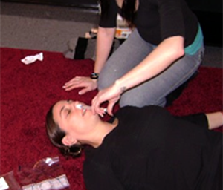
Respond to an overdose
  Alert EMS
  CPR – Rescue breathing
  Administer naloxone

Slide 23
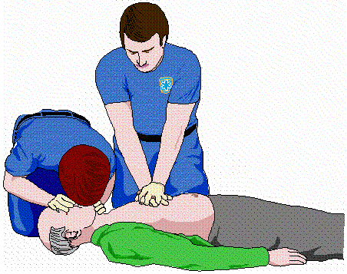
Does the person have a pulse?
Checking for a pulse, do it.
If no pulse? Then initiate CPR
Notes:
Image: http://crossfitdelawarevalley.com/2013/03/20/cpr-certification-at-cfdv-5-5-13/

Slide 24
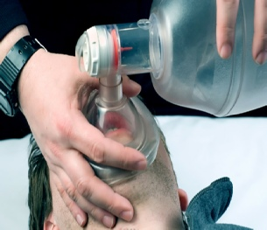
If an Opioid Overdose is Suspected
Step 1: Assess victim’s signs & symptoms
  Call for EMS support
Step 2: Stimulate the person - sternal rub
  If no pulse, start CPR
Step 3: Rescue breathing
Notes:
Image from: http://infusedmedical.com/ambubag.html

Slide 25
Suspected Opioid Overdose, continued
Step 4: Administer Naloxone
Step 5: Monitor and Support
If no pulse, start CPR
If breathing remains absent or slow
(< 8 per minute), continue rescue breathing + administer 2nd dose
If breathing restored, then recovery position

Slide 26
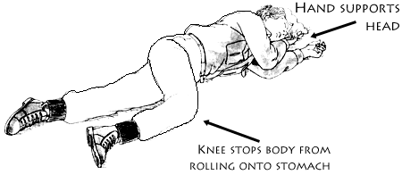
The Recovery Position

Slide 27
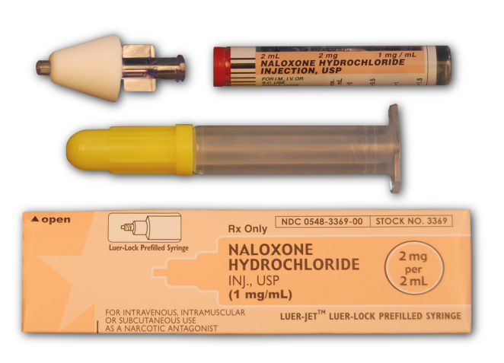
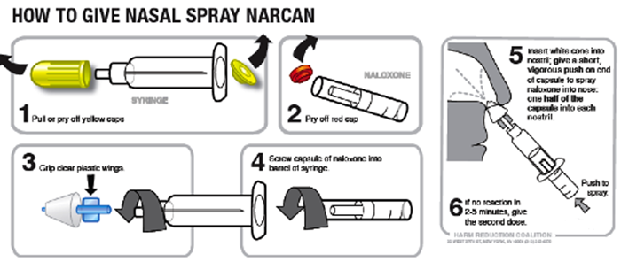
Rescue Kit Components
Prefilled ampule of naloxone
Mucosal Atomization Device (MAD)
Luer-lock syringe

Slide 28
Naloxone administration
Demonstration of atomizer, syringe and naloxone cartridge assembly

Slide 29
Intranasal Naloxone administration
Delivery route has advantages:
Its easy and convenient
The nose is a very easy access point for medication delivery (even easier than the arm, especially in winter)
No shots are needed
It is painless
It eliminates any risk of a needle
sticking to you

Slide 30
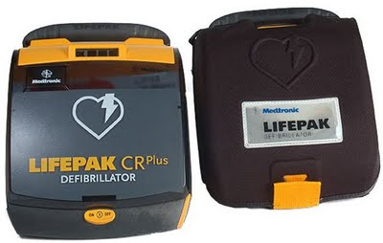
Naloxone storage & deployment
SPD -Attached to AED case which shall be kept in passenger compartment. No exceptions! Due to storage and exposure to the heat and cold
K-9 Units, front desk,
booking area.

Slide 31
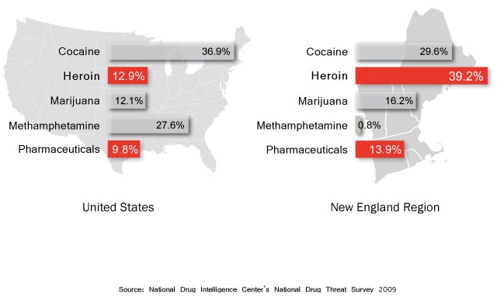
National & regional drug threat
Notes:
With this graphic point out the difference between national and New England region. Also ask people to name off some of the most commonly abused pharmaceuticals and be certain to identify which of them are opioids.

Slide 32
Local Drug Overdose Problem
The problem of fatal and non-fatal drug overdoses in Boston
Boston ranks higher than any other metropolitan area in the country for heroin mentions in emergency departments (DAWN, 2009)

Slide 33
The problem of drug overdoses
nationwide
Drug overdose is the number one cause of death among drug users in the United States (Latkin, 2004)
Overdoses kill more heroin injection drug users than AIDS, hepatitis, and other conditions that are related to their drug use (Sporer, 1999)
Between 1984 and 2004, deaths from mixing pharmaceuticals with alcohol and/or street drugs increased 3196% (Phillips, 2008)

Slide 34
The problem of drug overdoses
In Massachusetts
Car accidents is the number one cause of accidental death in the country, except for 16 states where more people die from drug overdose. Massachusetts is one of those 16 states (CDC, 2009)
In 2008, 12 Massachusetts residents died every single week from drug overdoses (MDPH, 2008)

Slide 35
Questions & Answers
Will Naloxone work on an alcohol OD?
What if it is a crack/cocaine or speed/methamphetamine overdose?
Are the ambulance and hospitals using the Nasal Naloxone?
Others?

Slide 36
Questions & Answers
Am I protected against a lawsuit for giving a person who is overdosing Naloxone?
What is the risk period for an OD to reoccur after giving Naloxone?
If the person isn’t overdosing and I give them Naloxone will it hurt them?

