Slide 1
Status of Body Worn Cameras Around the NCR
June 2016
Elliot Harkavy COG Public Safety Planner Police Technology Subcommittee June 30th 2016

Slide 2
Overall Survey Information
52 total responses as of June 26
  41 Unique Agencies
Date Created: Friday, June 10, 2016

Slide 3
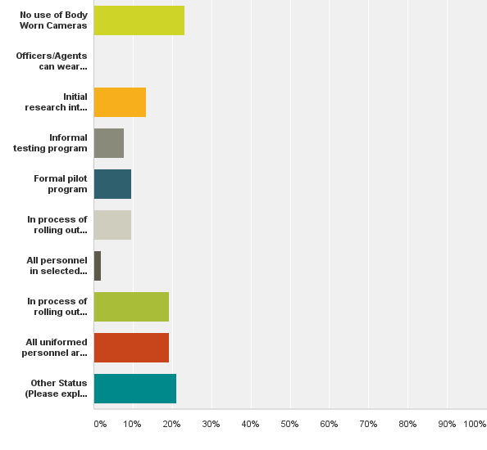
Q2: What is the status of Body Worn Cameras in your agency
Answered: 52 Skipped: 0

Slide 4
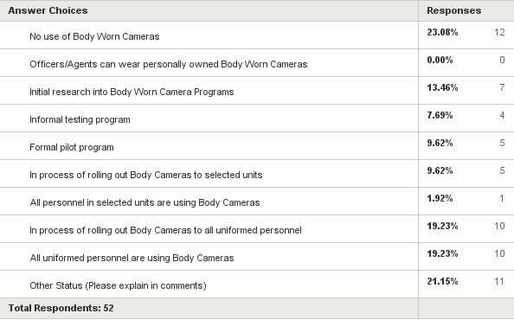
Q2: Agency Status Numerical Counts

Slide 5
Status: No Use of Body Cameras
Fauquier Co. Sheriff's Office
Amtrak Police Department
MWAA-PD
George Mason Univ. PD
Virginia State Police
Vienna Police Department
City of Manassas
Chevy Chase Village Police
United States Park Police
Federal Protective Service
U.S.Park Police
Landover Hills Police Department

Slide 6
Status: Initial research into BWC and/or Informal testing program
Rockville Police Department
Purcellville Police Department
Arlington County Police
Alexandria Police Dept
Fairfax County Police Department
Prince William County Police
Leesburg Police Department
National Park Service- Rangers

Slide 7
Status: Formal pilot program
Prince George's County Police Department
City of Fairfax Police Dept
Stafford Sheriff's Office

Slide 8
Status: In process of rolling out Body Cameras to selected units
City of Fairfax PD
Frederick Police Department
U.S. Department of the Interior

Slide 9
Status: All personnel in selected units are using Body Cameras
New Carrollton Police Department

Slide 10
Status: In process of rolling out Body Cameras to all uniformed personnel
Berwyn Heights Police
MPD of Washington, DC
Bowie PD
Hyattsville City Police Dept.
Montgomery County Police
Haymarket Police Department
Loudoun County Sheriff's Office
Fairmount Heights Police

Slide 11
Status: All uniformed personnel are using Body Cameras
Laurel PD
Takoma Park PD
Middleburg
Upper Marlboro Police Dept.
Edmonston Police
Cheverly Police
Mount Rainier PD

Slide 12
Status: Other Status
Virginia State Police
  A statewide contract for body worn cameras is in process. After that a pilot is possible
Herndon Police
  We have a few cameras but are currently working on a policy before implementing pilot program
Prince George’s County PD
  Planning on rolling out BWCs - awaiting delivery
Occoquan Police Department
  Waiting for Prince William County to finish their research and see who they contract with
Manassas Park Police
  All officers and detectives wear body cameras

Slide 13
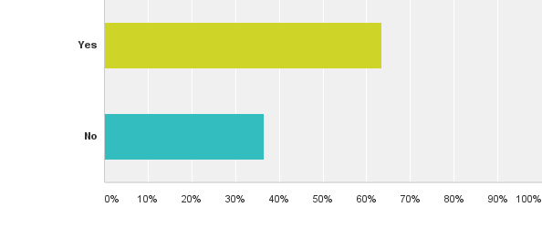
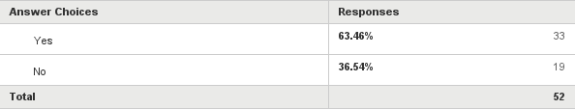
Q3: Has your agency selected a Body Worn Camera platform vendor?
Answered: 52 Skipped: 0

Slide 14
What Vendors were selected?
22 x Taser
4 x Panasonic
3 TBD or can’t discuss until contract awarded
Others:
  Body Cam, Switching to Digital ally
  Body Worn
  Coban
  Direct View
  OnCall
  Veho
  Vievu. Switching to Panasonic
  WatchGuard

Slide 15
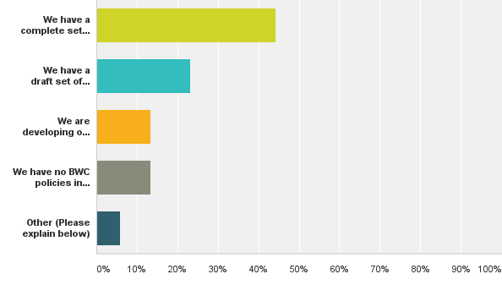
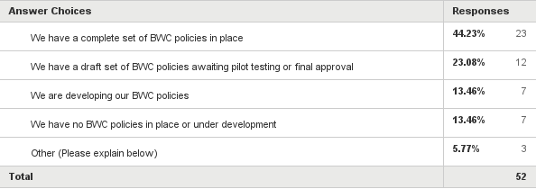
Q5: Does your agency have formal Body Worn Camera Policies?
Answered: 52 Skipped: 0

Slide 16
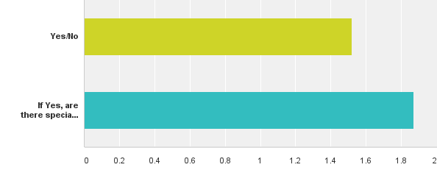
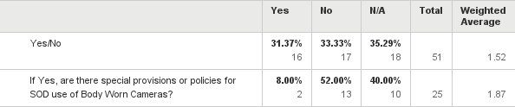
Q6: Are Special Operations Units included in BWC deployment plans
Answered: 51 Skipped: 1

