Slide 1




GFIPM FICAM
Status Update
GFIPM Delivery Team Meeting
November 2011

Slide 2
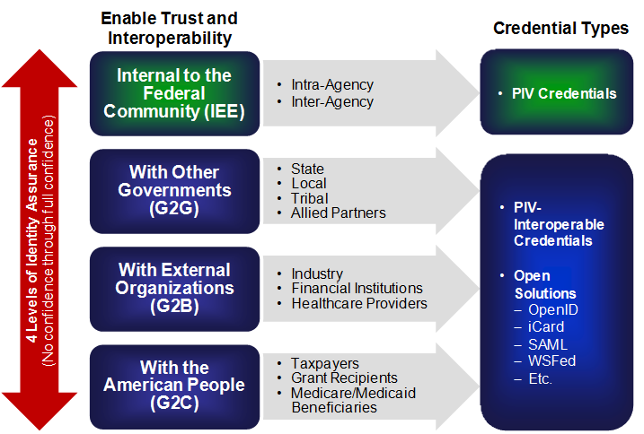
What is FICAM?
Persons
Non-Persons
Logical Access
Physical Access

Slide 3
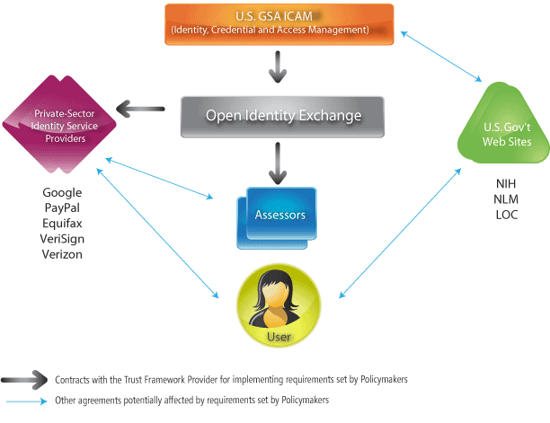
ICAM Identity Assurance Governance
PIV Credentials
U.S. Federal PKI
PIV-Interoperable Credentials
Open Solutions
OpenID
iCard
SAML
WSFed
Etc.
Trust Frameworks

Slide 4
FICAM Relation to GFIPM
FICAM/GFIPM:
  GFIPM can gain wider adoption of standards by conforming to FICAM framework
    Involves mostly minor changes to GFIPM specs
    Already identified required changes
FICAM/NIEF:
  NIEF can grow in size and scope by becoming a FICAM Trust Framework Provider (TFP)
    Requires GFIPM changes as a prerequisite

Slide 5
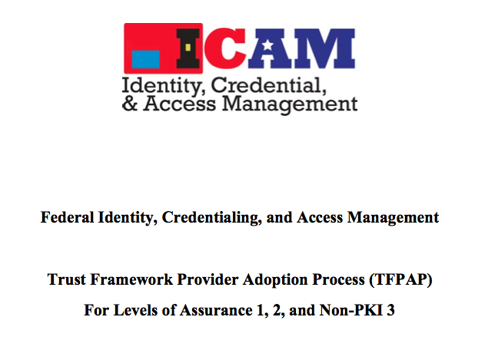
FICAM Trust Framework Provider Adoption Process (TFPAP)
FICAM structure includes “Trust Framework Providers” (TFPs)
TFP Adoption Process
  Defines criteria for becoming a TFP
  Criteria differ by NIST LOA
Several TFPs adopted
  Includes InCommon, others
  None at NIST LOA-3 yet

Slide 6
NIEF Adoption as FICAM TFP:
History and Current Status
“FICAM TFP Self-Assessment for NIEF”
  Document written by GTRI in Summer 2011
  Lays out six (6) steps required for TFP adoption
    See next slide
  Reviewed by FICAM reps w/ positive feedback
  Available for review
Next Step: Begin working through the steps
  Timeline is TBD (Funding?)

Slide 7
Steps for NIEF TFP Adoption (1-3)
Make minor alterations to the GFIPM Web Browser User-to-System Profile, and adopt it for use by NIEF IDPs and SPs.
  Must conform to FICAM SAML Profile.
Adopt a more clearly defined set of requirements regarding IDP assertion of identities at NIST LOA 2 and LOA 3 as defined in NIST Special Publication 800-63.
  Draft policy language already written.
Adopt a new set of policies regarding IDP and SP compliance with FICAM policies to protect the privacy of end-user data.
Source: “FICAM TFP Self-Assessment for NIEF”

Slide 8
Steps for NIEF TFP Adoption (4-6)
Develop appropriate frameworks and procedures to facilitate audits of both the NIEF Center and NIEF IDPs for compliance with applicable policies.
  Could entail significant cost.
Extend the GFIPM Metadata Spec to include a new entity attribute to express the maximum NIST LOA (or to list all LOAs) at which an IDP may assert identities.
Formally submit a FICAM TFP Assessment Package, and work with the FICAM Assessment Team as needed during the assessment process.
Source: “FICAM TFP Self-Assessment for NIEF”

