Slide 1




GFIPM Metadata
Status Update
GFIPM Delivery Team Meeting
November 2011

Slide 2
History of GFIPM Metadata
Evolved out of an early “strawman” exercise
  Collected attribute concepts from many agencies
  Reconciled ideas and built a standard set of terms
Version 1.0 approved by GAC in 2008
  User and entity attrs only; complex XML structure
Version 2.0 approved by GAC in 2010
  Added resource/action/environment attrs
  Changed to a flat attr structure for COTS compat.
Notes:
GFIPM Metadata began with a call for data requirements back in 2004-2005.
Agencies responded with specific concepts that factor into their authorization policies.
Built a strawman and vetted it through a series of iterations, leading to version 1.0 in 2008.
V. 1.0 used XML to define a NIEM-like data structure containing rich information about a user.
It proved to be difficult for implementers to use, and was more advanced than SAML implementations could handle.
Version 2.0 dropped the XML data structure in favor of flat attributes (name/value pairs).
V. 2.0 also introduced new categories of attributes, with an eye towards future integration between GFIPM and XACML-based authorization frameworks.
This XACML integration work has already begun. We will discuss it during this session.

Slide 3
Recent GFIPM Metadata Activity
Early 2011: Support for Inter-Federation/TIBs
  Improved structure of some attribute values
  Added a GFIPM Federation Name Registry
2010-2011:
  Proposed new attrs based on NCSC XACML work
Late 2010 to Present:
  Emerging concept of “obligation” metadata
    Based on work by Global Obligations Task Team
Notes:
Here is a summary of what has happened to the GFIPM Metadata spec since it was approved by GAC in 2010.
In early 2011, we updated several GFIPM attribute definitions to support the inter-federation use case with a Trusted Identity Broker (TIB).
During 2010-2011 GTRI has ben involved in a project for the National Center for State Courts (NCSC).
We have built a XACML-based prototype of several features within the GBI JIMnet application, as an implementation exercise.
JIMnet is a large legacy application for sharing criminal history data and other info.
This work led to the identification of several new attribute concepts that come from GBI’s authorization policies.
We want to present them to the GFIPM DT for consideration and possible inclusion in the GFIPM Metadata spec.
Over the past 12 months, a Global Obligations Task Team has been developing the concept of “obligation” metadata.
This work is still in an early stage at the technical level, but we will brief it during this session.
Eventually, the obligation concept should probably be absorbed into the GFIPM Metadata spec.

Slide 4
Trusted Identity Broker Concept
TIB = “Trusted Identity Broker”
  TIB is the service endpoint; TIBO is the agency
Brokers users to a federation SP from an IDP outside the federation
Example: FBI CJIS
  May join NIEF as a TIB soon
  Would broker several IDPs (e.g. Chicago PD) to NIEF SPs
  Bridges the technical gap, but not at policy level
Notes:
A TIB is the construct through which we achieve inter-federation data exchange in the GFIPM paradigm.
A TIB is much like an Identity Provider (IDP), but it represents users in a brokered relationship, rather than directly.
FBI CJIS is planning to join NIEF in the near future, and would become our first NIEF TIBO.
A TIBO is a “Trusted Identity Broker Organization”. A TIB is the software endpoint implemented by a TIBO.

Slide 5
GFIPM Direct Inter-Agency
Trust and Interoperability
Notes:
This diagram represents direct GFIPM inter-agency trust between an IDPO and an SPO.
Note that trust must be based on appropriate policy-level agreements and disclosure of local policies.
Without this, the cryptographic trust is meaningless.

Slide 6
GFIPM Inter-Agency Trust and Interoperability via a TIBO
Notes:
This diagram represents a brokered (inter-federation) trust relationship.
The IDPO is outside the GFIPM federation, and the SPO is inside it.
A TIBO “straddles” the trust boundary and provides technical connectivity between the IDPO and the SPO.
Note that even in this case, cryptographic trust and technical interoperability mean nothing unless the appropriate policies are in place.
The standard GFIPM governance and policy documents have been updated to cover the TIBO use case and reflect this need.

Slide 7
GFIPM Metadata Support for TIBs
Modified data formats for three attributes
  Federation Id (User Attribute)
    {Fed Name}:[TIB:{TIB}:]IDP:{IDP}:USER:{User ID}
  Identity Provider Id (User Attribute)
    {Fed Name}:[TIB:{TIB}:]IDP:{IDP}
  Entity Id (Entity Attribute)
    {Federation}:{Technical Role}:{Unique Entity ID}
Each attr’s format now supports TIB concept
Already approved by GFIPM DT in early 2011
Notes:
In early 2011, we modified several GFIPM Metadata attribute definitions to allow them to capture interfederation relationships.
Each of these attributes has a well-defined format that its value must follow.
On this slide, the following conventions apply.
“Curly” braces represent variables that would be populated with specific values.
“Square” brackets indicate optional parts of the format. The optional parts are related to the use of a TIB.
Federation Id
Used to uniquely identify a user within a federation.
Its format now allows for uniquely identifying a user both within and across federations.
It captures both the user’s original IDP, and, if applicable, the user’s TIB.
Identity Provider Id
Used to uniquely identify a user’s Identity Provider (IDP).
Its format now allows for identifying any IDP across federations, even if brokered by a TIB.
Entity Id
Used to identify entities: trusted software service endpoints in a GFIPM federation.
Entity IDs are entity metadata attributes that appear in the GFIPM Trust Fabric.
Its format now allows for several new technical roles: TIB and ADS.
ADS = SAML Assertion Delegate Service. See the Web Services slide decks for more info.

Slide 8
Attribute Format Examples
Federation Id Examples
“DOJTB:IDP:XYZ:USER:johndoe@example.org”
“NIEF:IDP:RISS:USER:riss.user@rissnet.net”
“NIEF:TIB:CJIS-Portal:IDP:RISS:USER:riss.user@rissnet.net”
“CONNECT:IDP:XYZ12:USER:johndoe99”
Identity Provider Id Examples
“NIEF:IDP:JNET”
“DOJTB:IDP:RISS”
“NIEF:TIB:CJIS-Portal:IDP:RISS”
“CONNECT:IDP:XYZ”
Entity Id Examples
“NIEF:IDP:JNET”
“CONNECT:SP:ABC”
“DOJTB:WSP:123”
“NIEF:TIB:CJIS-Portal”
Notes:
Each of these examples conforms to the corresponding attribute format on the previous slide.
The examples that contain red highlighted text illustrate the use of these attributes with TIBs.

Slide 9
GFIPM Federation Name Registry
New attr definitions require use of registered federation name
  Guarantees global uniqueness of Federation Id, Identity Provider Id, and Entity Id
List of registered names:
  http://gfipm.net/fed-registry.html
    “GFIPM” and “NIEF” are already assigned to NIEF
Request for registration of a new name:
  http://gfipm.net/register-fed-name.html
How to vet name registration requests:
  GFIPM Name Registration Process doc
Notes:
To avoid name collisions in the three attributes that we just discussed, we require that each GFIPM federation have a unique federation name.
To ensure global (not “Global”, but universal) uniqueness of federation names, we have established an online name registry.
The registry contains a list of already registered names, as well as a page of instructions describing how to register a new name.
We have also defined a process for vetting and approving/denying name registration requests.

Slide 10
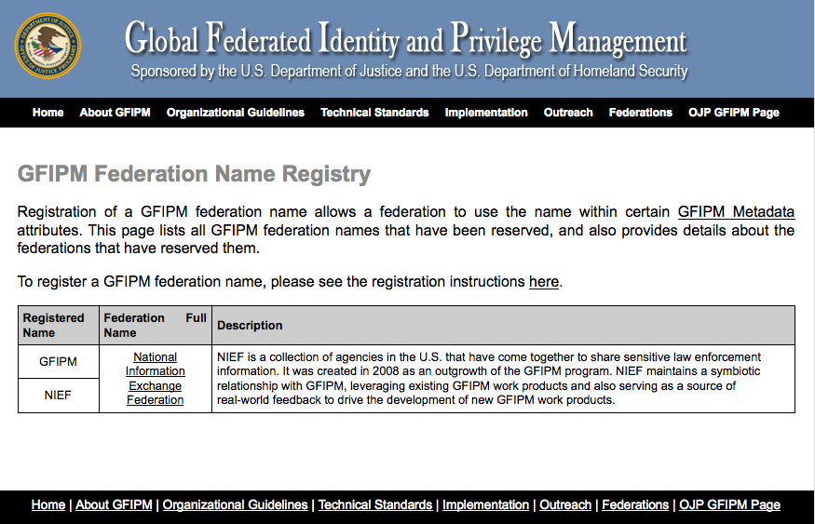
Name Registry Screen Shot
Notes:
This screen shot is from http://gfipm.net/fed-registry.html.

Slide 11
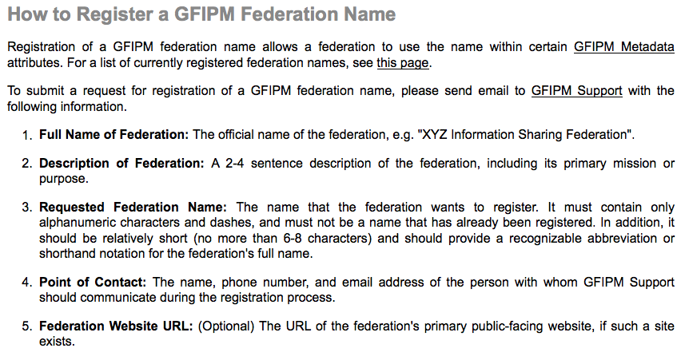
Screen Shot of Reg. Instructions
Notes:
This screen shot is from http://gfipm.net/register-fed-name.html.

Slide 12
Open Questions about Name Registry
GFIPM Federation Name Reg. Process doc
  Brief (3-page) document
  Where does it belong? (In the Metadata Spec?)
  Who acts as the “GFIPM Governing Body”?
  Who acts as “GFIPM Support”?
Open federation name reg. requests
  RISS: “RISS”
  LA County ISAB: “LAC-ISAB”
Notes:
Here are some open questions about the GFIPM Federation Name Registry.
Where does the name registration process document belong? Within the GFIPM Metadata spec, or as a standalone GFIPM document?
Who acts as the governing body for federation name registration requests? The GFIPM DT seems like an appropriate choice, for now. What about long-term?
Who acts as “GFIPM Support”? This is a technical support role called out in the document. GTRI fills that role for now. What about long-term?
There are currently two outstanding name requests: “RISS” and “LAC-ISAB”. Can we approve them now?

Slide 13
NCSC XACML Pilot Project
Funded via BJA grant to NCSC
Goal: Demonstrate the use of an externalized access control mechanism with an existing law enforcement information sharing system
  Integrate XACML with test instance of GBI JIMnet
  Implement info sharing policies from GBI Directive 7-6
Work Products:
  GBI rules expressed in XACML
  “XACML-enablement” prototype of GBI JIMnet
  Identification of potential new GFIPM attributes
Notes:
This work was funded from mid-2010 to year-end 2011, and is nearing completion now.
GBI = Georgia Bureau of Investigation
GBI JIMnet is a legacy application for sharing criminal history and other law enforcement data.
This project produced several noteworthy deliverables.
For this discussion, the most significant deliverable is a list of new attribute concepts for possible inclusion in the GFIPM Metadata spec.

Slide 14
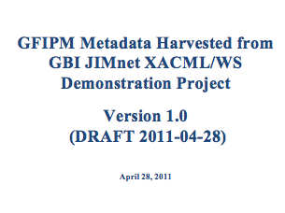
New Attributes Identified
Summary of Results:
  No new User Attrs
  No new Entity Attrs
  Five (5) new Resource Attrs
  Four (4) new Action Attrs
  One (1) new Environment Attr
  Four (4) new Obligation Attrs*
New attrs recommended for GFIPM Metadata
Report available for DT review
* Obligations are not yet part of the GFIPM Metadata Spec.
Notes:
We identified 14 new attribute concepts that we are proposing for consideration by the GFIPM DT for inclusion in GFIPM Metadata.

Slide 15
Recommended New Attributes (1/3)
Resource Attributes
  “Subject of Resource” Category
    Code Set: “Adult”, “Juvenile”, “Sealed”, etc.
  Data Classification Category
    Code Set: “Sensitive”, “Classified”, “GBI Only”, etc.
  Data Jurisdiction
    Code Set based on jurisdictions
  Resource ID
  Criminal Activity Category
    Code Set: “Assault”, “Arson”, “Robbery”, etc.

Slide 16
Recommended New Attributes (2/3)
Action Attributes
  Query Action Category
    Code Set: “NCIC Record”, “NLETS”, “AFIS”, etc.
  Query Purpose Category
    Indicates purpose of a criminal history query
    Code Set: “Lawyer”, “Public Records”, etc.
  Criminal Activity Description (Text)
    Description of criminal activity motivating the query
  Access Mode (“Local” or “Remote”)
Notes:
Note that “Query Purpose” is essentially the same as the concept of “Authorized Purpose”.

Slide 17
Recommended New Attributes (3/3)
Environment Attributes
  Imminent Danger Indicator (Boolean)
    May need to be self-asserted by user
Obligations
  “Must Get User Consent to Disclaimer”
  “Must Log Access”
  “Must Notify Data Owner”
  “Must Redact Data from Results”

Slide 18
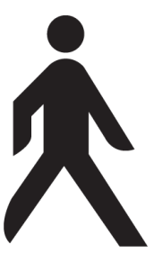
Refresher on Authorization and
Privacy Framework
_{Identity Providers}
_{Security & Privacy}
_{Policy Services}
_{Service Providers}
Actions: release, store,
modify, access PII, access w/o PII
Request
message
Identity
credentials
Response
message
Access
Obligations
PEP
PDP
Audit
trail
Obligations
Electronic policy statements (dynamic, federated)
Written policy
Environmental
conditions
PEP: Policy Enforcement Point
PDP: Policy Decision Point
Notes:
This diagram depicts the standard Global “Authorization and Privacy Framework”.
A user performs an action on a system.
The system mediates access control to protected resources in accordance with written policy.
PEP = Policy Enforcement Point
PDP = Policy Decision Point
Written policy (laws, statutes, privacy statements, etc.) is translated into electronic policy.
The most prevalent industry standard for electronic policy is XACML.
XACML = eXtensible Access Control Markup Language
Based on the access control decision, an audit trail is generated.
The access control decision may include one or more obligations.
An obligation is an ancillary action that some party must take as a result of the transaction.
E.g. “Notify the data owner” or “Delete this data from your local system within 30 days”.

Slide 19
What is an Obligation?
Action that must be performed to fulfill an authorization or privacy policy
  Separate from the YES/NO access decision
  Examples:
    “Notify Data Owner of Access”
    “Redact all PII Data”
Can be precisely defined and modeled via XML
  Includes both schemas and instances
Can be fulfilled via an “obligation handler”
  Software that conforms to the obligation definition
Notes:
Obligations are part of the XACML spec, but they are domain-specific in nature.
Just like GFIPM Metadata attributes, applicable obligations can be collected in a dictionary.
We can define abstract obligation concepts using XML schemas.
We can express specific, concrete obligations using XML objects (instances).
Obligations must be handled, i.e. fulfilled, by an obligation handler.

Slide 20
Global Obligations Task Team
Convened at GISST meeting in Oct 2010
  J. Ruegg, S. Came, J. Dyche, I. Topalova, M. Moyer
Goals and Progress in 2011:
  Identify obligation concepts in laws and policies
    DONE
  Identify common patterns among obligation concepts
    DONE
  Develop syntax and structure for expressing obligation concepts
    ONGOING

Slide 21
Laws and Policies Analyzed
Privacy Act of 1974
Freedom of Information Act
Florida Fusion Center Privacy Policy
CFR 28 Part 23
HIPAA Administrative Simplification Statute
Colorado Health and Hospital Assoc. Data Use Agreement
Colorado Cancer Stats Data Sharing MOU
Colorado Data Retention and Destruction Template
Notes:
The first task of the Global Obligations Task Team was to read several existing laws and policies, and extract the basic obligation concepts contained in those policies.
We have collected those concepts in a series of spreadsheets.

Slide 22
Obligation Concepts Identified
Notify
Redact
Delete Data
Log
Obtain Consent
Obtain Acknowledgment from User
Restrict Usage To…
No Secondary Dissemination
No Contact with Subject
Purge Within N Days
Notes:
After collecting many obligation concepts, we identified the common, recurring themes among them.

Slide 23
Ongoing Work
Developing a standard structure for expressing obligations precisely
  Conceptual model
    Obligor: Who must perform the obligation?
    Obligee: For whom must it be performed?
    Action/Content: What must be performed?
    Deadline: By when?
  Technical model (XML schemas and instances)
Target completion date: 1Q or 2Q 2012
  Will recommend addition to GFIPM Metadata Spec
Notes:
Our ongoing work involves the development of a standard structure for expressing obligations precisely.
Our conceptual model includes several common features of all obligations.
Common Obligors and Obligees:
Data Custodian
Data Requestor
Data Subject
Data Owner
Data Contributor
We are also developing a “Global Obligations Processing Model”.
The scope of possible obligation concepts is vast.
This is a formal model to help define what obligation concepts are in scope versus out of scope.

Slide 24
Example Notify Obligation Instance*
<Obligation Name="Notify">
<ObligationAttribute Name="Obligor">
<ObligationAttributeValue>
Matt Moyer
</ObligationAttributeValue>
</ObligationAttribute>
<ObligationAttribute Name="Obligee">
<ObligationAttributeValue>
John Ruegg
</ObligationAttributeValue>
</ObligationAttribute>
<ObligationAttribute Name="Content">
<ObligationAttributeValue>
Your medical record was accessed on
2011-10-27 by Dr. John Doe.
</ObligationAttributeValue>
</ObligationAttribute>
<ObligationAttribute Name="Deadline">
<ObligationAttributeValue>
Fri Oct 28 18:00:00 EDT 2011
</ObligationAttributeValue>
</ObligationAttribute>
</Obligation>
* Not a realistic example, in content or structure. For illustration purposes only.
Notes:
This is an example of how an obligation may look when expressed in XML.
It is vastly oversimplified, but conveys the basic information that an obligation would contain.
In reality, the various attribute values would be more tightly bound to concrete endpoints (e.g. email addresses, service endpoints, etc.) to allow for automated processing by obligation handler software.

