Slide 1




Status Update on
Other GFIPM Activity Threads
GFIPM Delivery Team Meeting
November 2011

Slide 2
Other GFIPM Activity Threads
NCSC/GBI XACML Sample Implementation
Privacy Policy Framework Implementer Guide
GFIPM/BAE Interoperability Pilot
SAML Holder-of-Key Profile Implementation
CONNECT Consortium Update (Rob Kribs)

Slide 3
NCSC/GBI
XACML Sample Implementation
Status Update

Slide 4
NCSC/GBI XACML
Sample Implementation
Funded via BJA grant to NCSC
  Period of Performance: Mid 2010 to EOY 2011
Goal: Demonstrate the use of an externalized access control mechanism with an existing law enforcement info sharing system
  Integrate XACML with GBI JIMnet test instance
  Implement info sharing policies from GBI Directive 7-6
Work Products:
  GBI rules expressed in XACML
  Identification of potential new GFIPM attributes
  “XACML-enablement” prototype of GBI JIMnet
    Also conformant to GFIPM web services spec

Slide 5
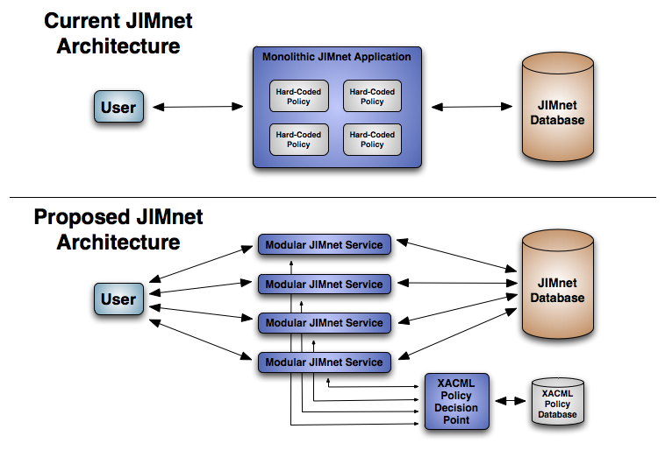
JIMnet Architecture
Notes:
The current JIMnet architecture is monolithic, with access control policy logic hard-coded in both the application source code and in stored procedures in the database.
The proposed architecture is modular and service-oriented, with access control policy logic decoupled and externalized from application code.

Slide 6
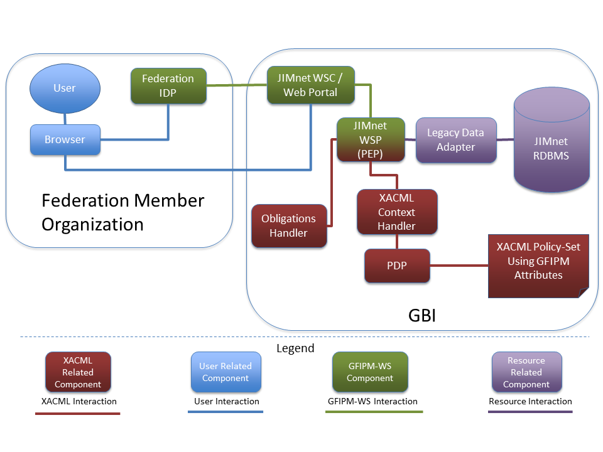
Prototype Architecture with
XACML and GFIPM Web Services
Notes:
This diagram depicts the structure of the JIMnet prototype that we built.
An end-user connects to a JIMnet Web Portal, and the portal acts as a Web Service Consumer (WSC), making WS requests to a JIMnet Web Service Provider (WSP).
The WSP connects to the JIMnet database via a legacy data adapter.
The WSP implements XACML Policy Enforcement Point (PEP) functionality and is integrated into a XACML enterprise authorization framework.

Slide 7
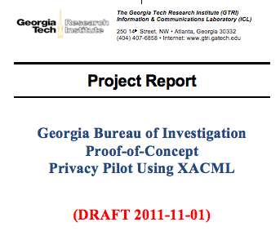
NCSC/GBI Project Final Report
Draft submitted to NCSC on 11/1
Final draft to be complete by EOY 2011
Notes:
The final report for this project will be complete in December 2011.

Slide 8
Privacy Policy Framework
Implementer Guide
Status Update

Slide 9
Privacy Policy Framework Implementer Guide
Funded via BJA grant to NCSC
  Period of Performance: Late 2011 to Mid 2012
  Follow-on to GBI XACML implementation work
Goal: Develop an implementer guide/tutorial for implementing a XACML-based authorization/privacy framework
  Will include implementation exercises, sample code/solutions, etc.
Currently in early phase

Slide 10
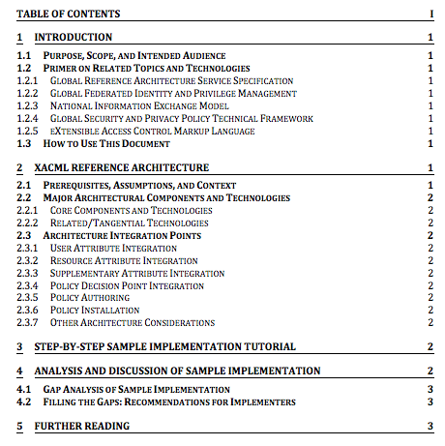
Privacy Policy Framework
Implementer Guide TOC
Notes:
This is a draft table of contents (TOC) for the implementer guide.

Slide 11
GFIPM/BAE Interoperability Pilot Status Update

Slide 12
HSPD-12 Back-End Attribute Exchange
Supports operation of PIV and PIV-I cards
  Personal ID card with embedded crypto token
Delivers additional attributes not on cards
Protocol spec and system implementation
  Uses SAML 2.0 Attribute Query Profile
  Technical support provided by JHUAPL
BAE defines ~35 data attributes about users
  Already reconciled with GFIPM Metadata 2.0
Notes:
JHUAPL = Johns Hopkins University Applied Physics Lab

Slide 13
GFIPM/BAE Interoperability Pilot
Pilot project initiated in mid-2010
Use Case: BAE user accesses GFIPM resource
  BAE user authenticates to GFIPM IDP (TIB)
  GFIPM IDP collects BAE user attributes
    This is the primary GFIPM/BAE integration point
  GFIPM IDP translates BAE attrs to GFIPM attrs
    Mapping from BAE to GFIPM attrs already exists
  GFIPM IDP sends SAML assertion to GFIPM SP
  BAE user accesses GFIPM resource
Notes:
See the following slide for a diagram depicting this use case.

Slide 14
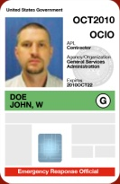






Proposed GFIPM/BAE Use Case
User with
PIV or PIV-I Card
Authoritative
Attribute
Source 1
GFIPM
Relying Party
Authoritative
Attribute
Source 2
Virtual/Meta
Directory
XML
Security
Gateway
(BAE)
Trusted
Identity Broker
Authoritative
Attribute
Source 3
GFIPM
Relying Party
State & Local
Agency Attribute
Service
Notes:
Steps in this Use Case:
BAE user authenticates to GFIPM IDP (TIB)
GFIPM IDP collects BAE user attributes. (This is the primary GFIPM/BAE integration point.)
GFIPM IDP translates BAE attributes to GFIPM attributes. (A mapping from BAE to GFIPM attributes already exists.)
GFIPM IDP sends SAML assertion to GFIPM SP
BAE user accesses GFIPM resource

Slide 15
GFIPM/BAE Pilot Status
Held initial technical discussions with JHUAPL
GTRI is prototyping the GFIPM components
  Will connect to existing BAE test-bed
BAE client-side software does not exist
  Must perform SAML attr query over web svcs
  GTRI will develop it using GFIPM WS sample code
Timeline is TBD
  Gated in 2011 due to GFIPM WS development
  Sought funding in 2010 – not a high priority then

Slide 16
SAML Holder-of-Key (HoK) Profile
Implementation
Status Update

Slide 17
SAML Holder-of-Key (HoK) Profile
Extension to the core SAML spec
  OASIS Committee Specification (not ratified yet)
  No implementations available yet
Enables NIST level of assurance 4 (LOA-4)
  LOA-4 requires direct authentication with RP
  Traditional SAML provides assertion only
  SAML HoK provides hybrid direct authn/assertion
Plan: Seek funding to extend Shibboleth w/ HoK
  Most groups using SAML don’t need LOA-4 authentication
  Justice community requires it for some data exchanges
Current Status: on hold pending demand/funding

