Slide 1




GFIPM Web Services Concept and
Normative Standards
GFIPM Delivery Team Meeting
November 2011

Slide 2
User-to-System Use Case
Web Browser Connections
Notes:
Early in the GFIPM program, we identified two major use cases: User-to-System and System-to-System.
User-to-System is geared towards user-facing, web-browser accessible applications.
The U-to-S use case includes single sign-on (SSO) as a requirement.
We solve the U-to-S use case using the SAML Web SSO Profile.
It would be more accurate to call this a “family” of several use cases.
IDP-first SSO
SP-first SSO
E.g. User receives email and clicks on link to a secure web application.
E.g. User bookmarks the URL of a protected resource and visits it later.

Slide 3
System-to-System Use Case
SERVICES
Notes:
System-to-System is for interactions that do not directly involve a web browser or a user interface
Note that S-to-S interactions can still involve a user, i.e. systems can act on behalf of a user
We approach the System-to-System use case with SOAP-based web services
It is also possible to solve this problem using the REST web service paradigm, but we focus on SOAP only – for now
This is also a family of use cases, as the next few slides will illustrate.

Slide 4
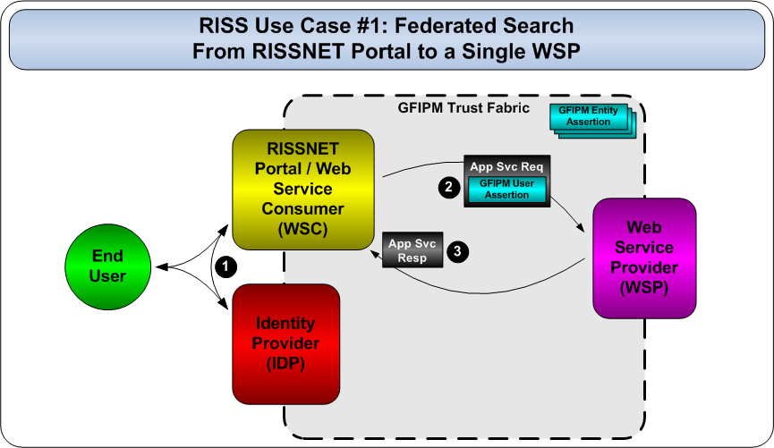
System-to-System Use Case Example 1
Notes:
In 2009, we developed a CONOPS doc to help us better understand the specific drivers for web services
What specific solutions did we need to deliver for the community?
The CONOPS doc includes several appendices, written by GFIPM stakeholder agencies, in which they explain their specific S-to-S use cases in detail
CISA, RISS, JNET, CONNECT
This use case depicts a federated search on behalf of a RISS user, through the RISSNET portal

Slide 5
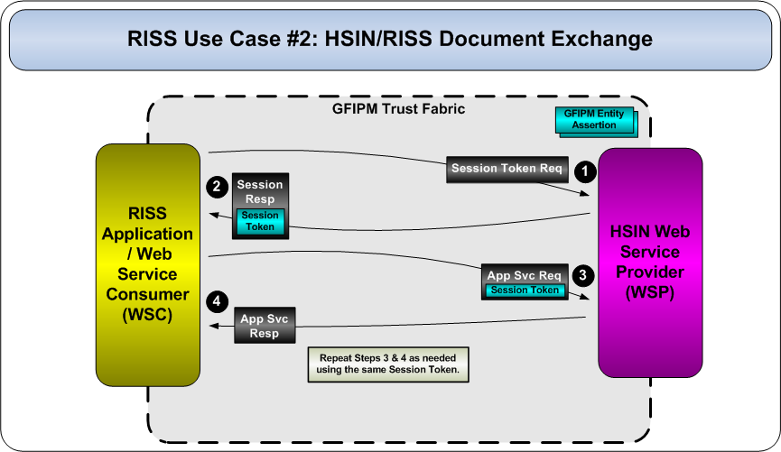
System-to-System Use Case Example 2
Notes:
This use case depicts a series of transactions between RISS and HSIN, over a single session.
There is no user involved in these transactions.

Slide 6
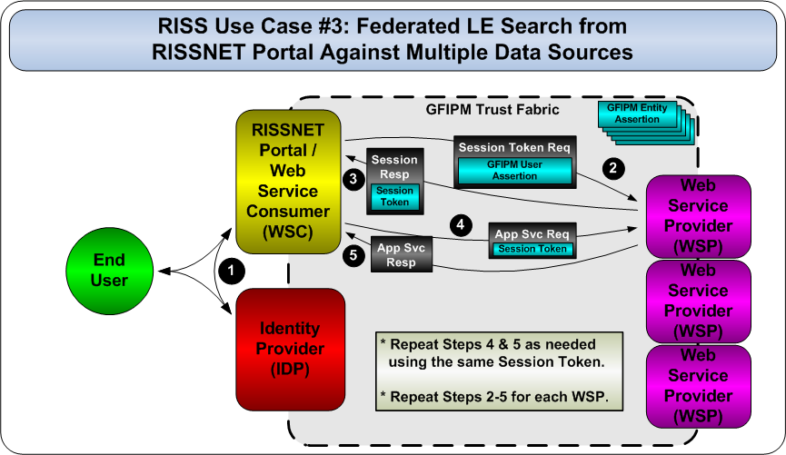
System-to-System Use Case Example 3
Notes:
This is another federated search use case for RISS.

Slide 7
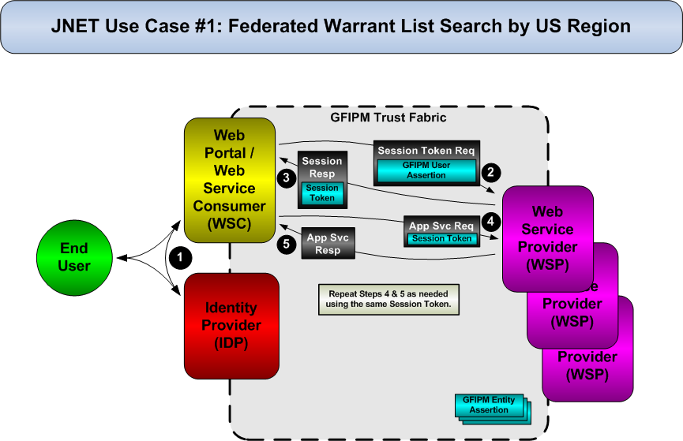
System-to-System Use Case Example 4
Notes:
This is a federated search use case for JNET.
Clearly, federated search on behalf of a user is an important use case.

Slide 8
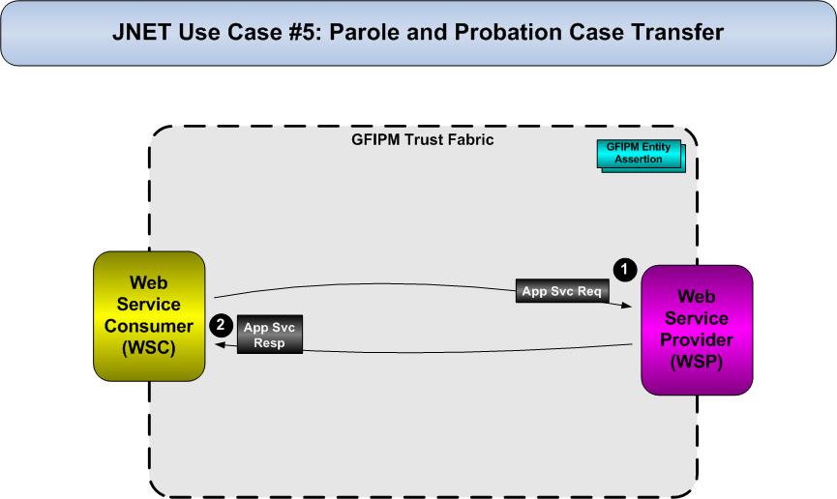
System-to-System Use Case Example 5
Notes:
This is a simple JNET S-to-S transaction for case transfer.
It involves no user, and no sessions.

Slide 9
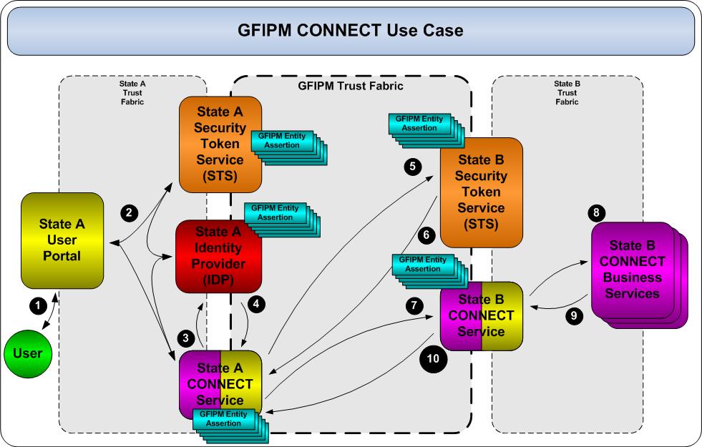
System-to-System Use Case Example 6
Notes:
This is a more complex use case submitted by CONNECT.
A user from State A accesses a generic business service in State B.
The use case includes a pair of security token services (STSes).
STSes are commonly used within enterprise architectures for externalizing certain security services from application-level services.
For example, an STS could act as an authorization service, and make decisions as to whether a consumer can use a particular app service.

Slide 10
Recurring Themes in Use Cases
Users
Sessions
  Necessary in many cases for performance
Token Services
  Common in enterprise web service architecture
Identity Brokers
  Allows non-GFIPM users to access GFIPM services
Crypto Trust Fabric
Notes:
We must support use cases with and without users.
We must support sessions of various flavors (user, no user, multiple users).
We must support various flavors of token services.
We must support identity brokers to handle the inter-federation use case.
We must do all of this in a way that jibes with GFIPM’s concept of “Trust Fabric”.
Trust Fabric is GFIPM’s way of defining the members of a federation at the system/service level.
It is a document signed by the federation mgr. and distributed to all member agencies.
It contains certificate data and other metadata about each system.
It is updated whenever the federation membership changes.

Slide 11
Service Interaction Models
Set of models that provide abstractions of real-world use cases
Initially defined in GFIPM-WS CONOPS doc
Supported via normative “service interaction profiles” in GFIPM-WS Profile
Notes:
Based on the use cases contributed by stakeholders, we defined a set of conceptual “Federated Service Interaction Models”.
These models have matured into formal, normative Service Interaction Profiles, which are defined in the GFIPM WS S-to-S Profile document.
Commonly used terms:
Web Service Consumer (WSC)
Web Service Provider (WSP)
Identity Provider (IDP)
Trusted Identity Broker (TIB)
Security Token Service (STS)

Slide 12
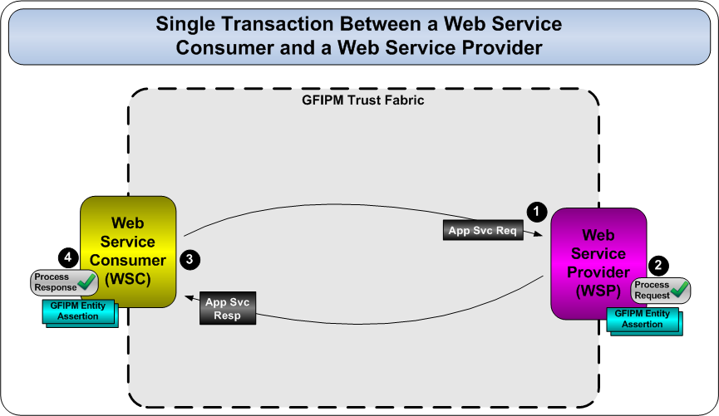
Service Interaction Model #1
Notes:
Model #1 has no users, no sessions, no identity brokers, and no token services.

Slide 13
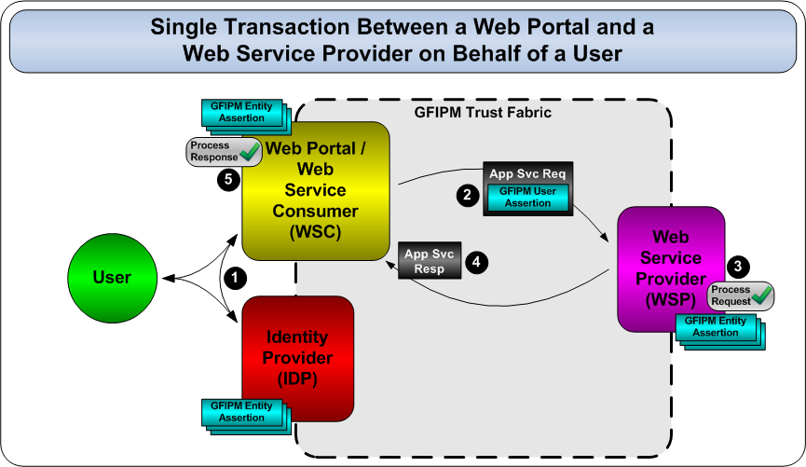
Service Interaction Model #2
Notes:
Model #2 introduces a user.
It still has no sessions, no identity brokers, and no token services.
Note that in Step 1 of this model, the user authenticates to the Web Portal.
The mechanism used by the user to accomplish this is OUT OF SCOPE for the purpose of web services.

Slide 14
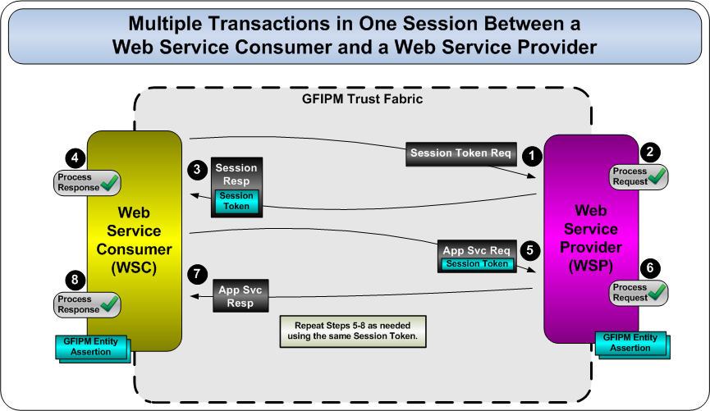
Service Interaction Model #3
Notes:
Model #3 introduces sessions, but does not include a user.
The session is strictly for performance concerns.
This is the case with all models that include sessions.

Slide 15
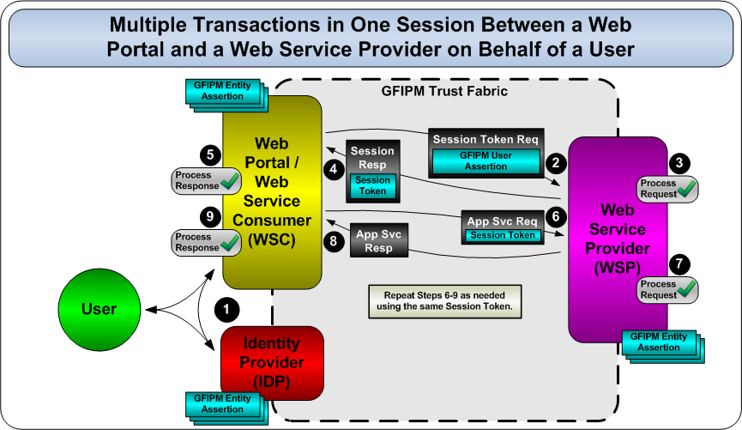
Service Interaction Model #4
Notes:
Model #4 defines an interaction involving a user and a session.

Slide 16
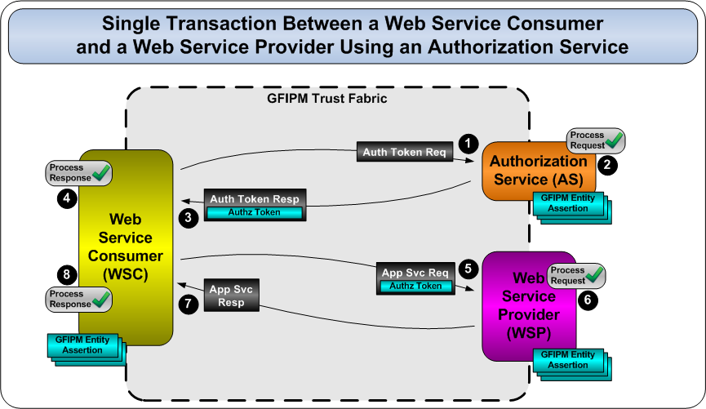
Service Interaction Model #5
Notes:
Model #5 includes an STS in the role of an Authorization Service (AS).

Slide 17
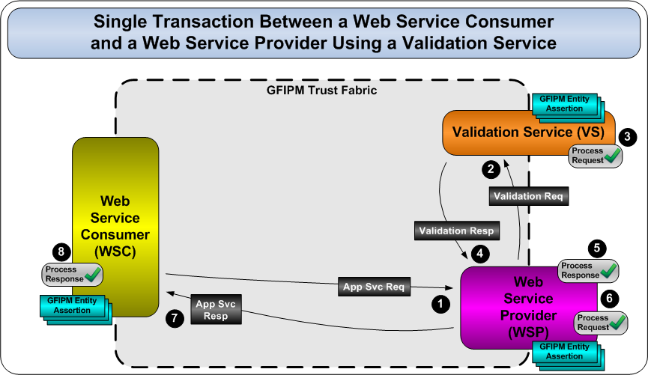
Service Interaction Model #6*
* Defined in CONOPS, but later deemed unnecessary
Notes:
Model #6 includes an STS in the role of a Validation Service (VS).
This model was included because a VS is defined by the WS-Federation spec and was originally thought to be a useful service in a federation.
We later determined that it is unnecessary.
It is not clear what value a VS provides.
The model, as depicted, degenerates in to two instances of Model #1.

Slide 18
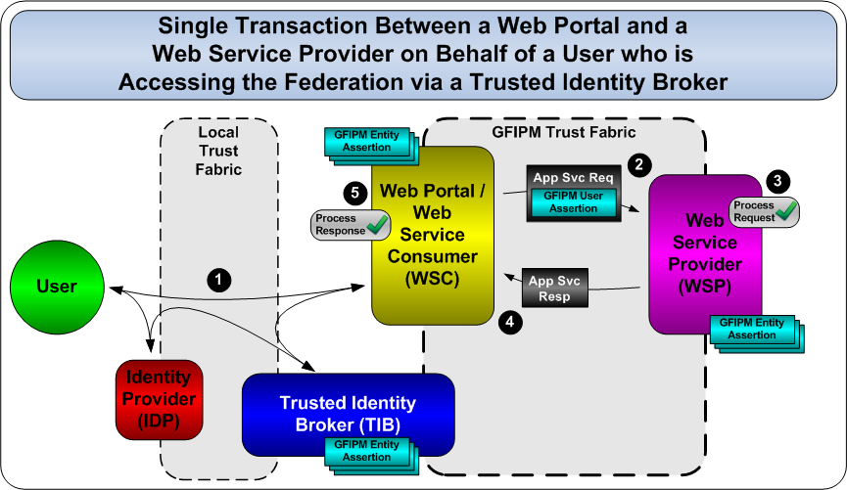
Service Interaction Model #7
Notes:
Model #7 includes a Trusted Identity Broker.
It is the same as Model #2, but with a user from outside the federation.
At the technical/protocol level, it is EXACTLY the same as Model #2.

Slide 19
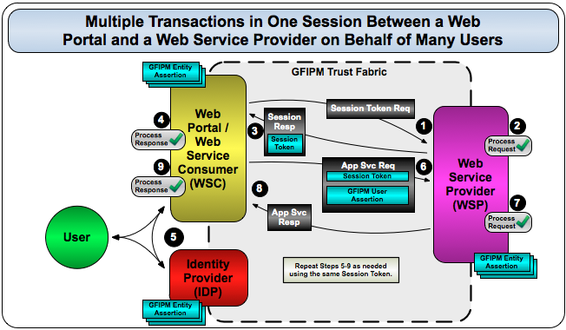
Service Interaction Model #8*
* Not defined in original CONOPS doc; subsequently identified by FBI CJIS
Notes:
Model #8 comes from FBI CJIS.
It covers a case in which requests are made by multiple users over the same long-standing session between WSC and WSP.
It was not in the original CONOPS doc, but was later identified and is in the GFIPM WS S-to-S Profile.

Slide 20
GFIPM WS Technical Roles (1/2)
SAML Service Provider (SP)
  Provides web-based access to app-level services
Identity Provider (IDP)
  Authenticates users and issues user assertions
Trusted Identity Broker (TIB)
  Issues assertions for users from brokered IDPs
Notes:
In the course of defining the scope of GFIPM web services, we encountered some clashes in nomenclature between various paradigms.
GFIPM
SAML
GRA/SOA
To disambiguate these clashes and clarify the definitions of GFIPM terms, we created a doc called the GFIPM Terminology Matrix.
The matrix defines these terms.
SAML SP
IDP
TIB
WSP
WSC
STS

Slide 21
GFIPM WS Technical Roles (2/2)
Web Service Provider (WSP)
  Provides one or more app-level web services
Web Service Consumer (WSC)
  Accesses web services on behalf of a user or org
  Implemented as part of an application or portal
Security Token Service (STS)
  WSP that issues security tokens to WSCs
  Tokens are accepted by other WSPs

Slide 22
GFIPM WS Technical Roles
Authorization Service (AS)
  STS that makes authorization decisions
  Issues security tokens to WSCs, for use with WSPs
SAML Assertion Delegate Service (ADS)*
  STS that issues SAML assertions for WSCs
  Co-located with IDP
  Required for conformance with SAML
    “Audience Restriction”
    “Subject Confirmation Method”
* Not in original CONOPS doc; identified through implementation experience
Notes:
An STS can act in several specific roles.
WS-Trust/WS-Federation define a handful of roles: Authorization Service, IDP, Validation Service, etc.
In GFIPM web services, we have defined only two roles that an STS is permitted to take on.
AS
ADS (Will elaborate on next slide.)
These are the only roles that make logical sense within the GFIPM paradigm.

Slide 23
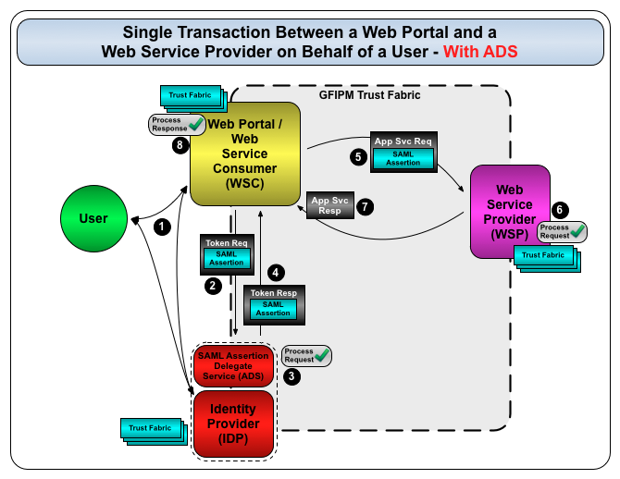
Example Use of an ADS
Notes:
An ADS is an STS that reissues SAML assertions on behalf of users.
SAML processing rules demand that an assertion have characteristics.
Audience Restriction – Recipient of the SAML assertion must be the intended recipient (i.e. no assertion forwarding)
Subject Confirmation Method – Recipient of SAML assertion must properly confirm the subject (again, no assertion forwarding)
Bearer: Used in SAML SSO, where the subject literally “bears” the assertion and delivers it directly to the relying party
Sender-Vouches: Used when a 3rd party (e.g. WSC) vouches for the subject and delivers on subject’s behalf
Holder-of-Key: Used for direct authentication of subject to relying party
This diagram depicts how Model #2 actually works at the protocol level.
The WSC has already received a SAML assertion for this user from the user’s IDP.
The WSC cannot simply forward the assertion to the WSP; it must request a new assertion from the ADS.
The ADS is co-located with the IDP.
The interaction between the WSC and ADS is itself a GFIPM web services transaction.
Conforms to “Model #1”, with SAML assertions as the payload in the request and response.

Slide 24
GFIPM WS Functional Reqs 1-7
GFIPM System Entity Metadata
Message Sender Authentication
Web Service Consumer Authorization
Web Service User Authorization
Message Nonrepudiation and Integrity
Message Confidentiality
Message Addressing
Notes:
In addition to the interaction models, the CONOPS also defines 13 baseline functional requirements that apply to all of the models, as needed. (See this slide and next.)
Some are core security requirements.
Some are GFIPM-specific security requirements.
Some are driven by a specific GFIPM interaction model, e.g. session support or STS support.
The others are driven by the goal of conformance with the GRA.
These requirements are represented as normative language in the S-to-S Profile doc.

Slide 25
GFIPM WS Functional Reqs 8-13
Message Reliability
Transaction Support
Service Metadata Availability
Interface Description
Session Support
Security Token Service Support

Slide 26
Web Services Standards Landscape
Basic Standards
  XML, SOAP, WSDL, HTTP, XML-Encryption, XML Signature, WS-Addressing
Security Standards
  WS-Security, WS-Trust, WS-Policy, WS-SecurityPolicy, WS-SecureConversation, SAML
Interoperability Profiles
  WS-I Basic Profile, WS-I Basic Security Profile, WS-I Reliable Secure Profile
Notes:
When writing the normative language for GFIPM web services, we needed to pull together many layers of standards.
Basic XML, HTTP, crypto, and core web services industry standards
Security-specific industry standards
Interoperability Profiles defined by industry consortiums (WS-I, now OASIS)

Slide 27
Global Reference Architecture
Describes a service-oriented reference architecture for public safety info sharing
GRA-based work products include service interaction profiles (SIPs), execution context guidelines, service specification pkgs, etc.
Goal: Make all GFIPM web services normative language conform to appropriate GRA docs
  Alignment effort in 2010 via “Std. Global Package”
Notes:
We also needed to conform to the Global Reference Architecture (GRA).
In mid-2010 we worked with GISWG members on an extensive analysis and reconciliation effort between GFIPM web services and the GRA WS profiles.
The goals of the reconciliation effort were consistency, interoperability, and implementability of all Global standards.
It included a cursory analysis of several popular web services platforms (Java Metro, .NET, and others) to confirm implementability.
GISWG = Global Infrastructure and Standards Working Group
This effort was part of a broader reconciliation and interoperability effort across Global products. It led to a “Standard Global Package”.
GRA is a very broad Service Oriented Architecture (SOA) framework that is designed to provide a baseline of best practices for implementing services.
GISWG has defined a baseline GRA as well as various SIPs.
We chose to align all GFIPM web services profiles with the GRA Reliable Secure Web Services Profile (GRA RS WS-SIP).

Slide 28
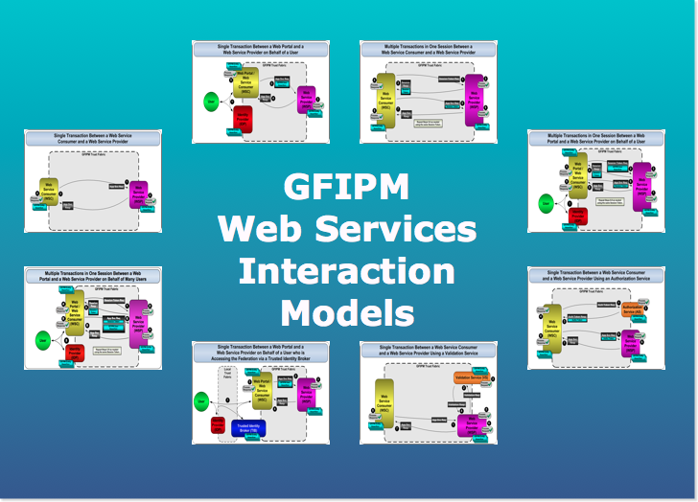
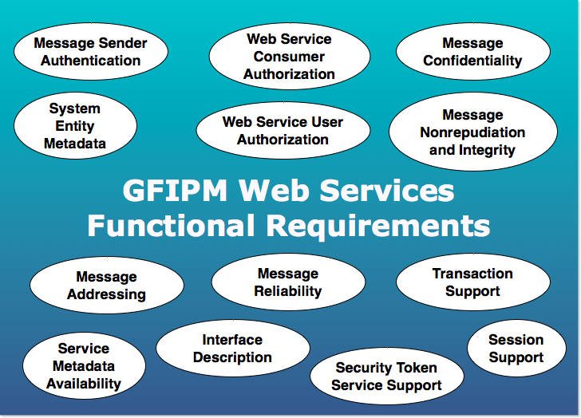
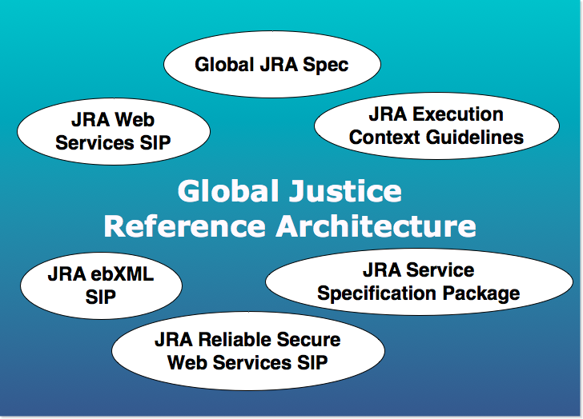
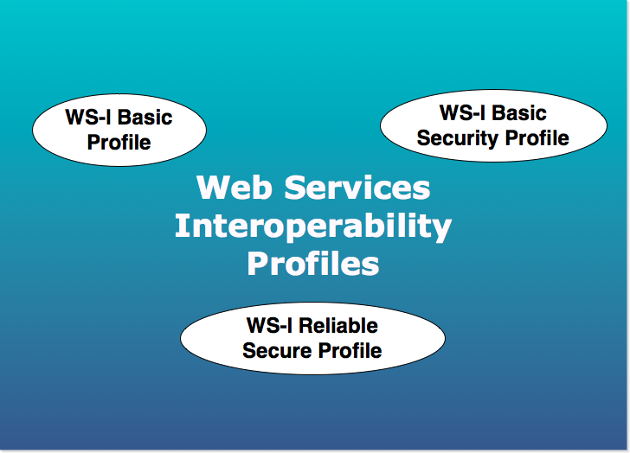
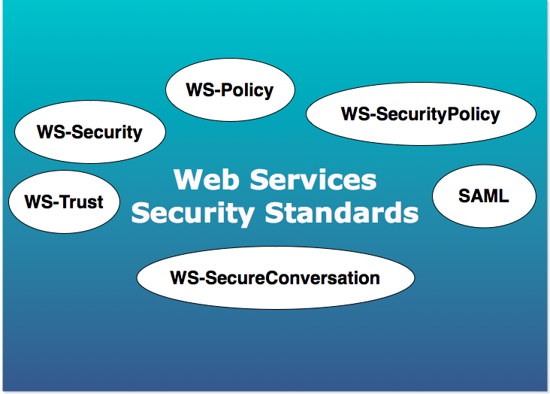
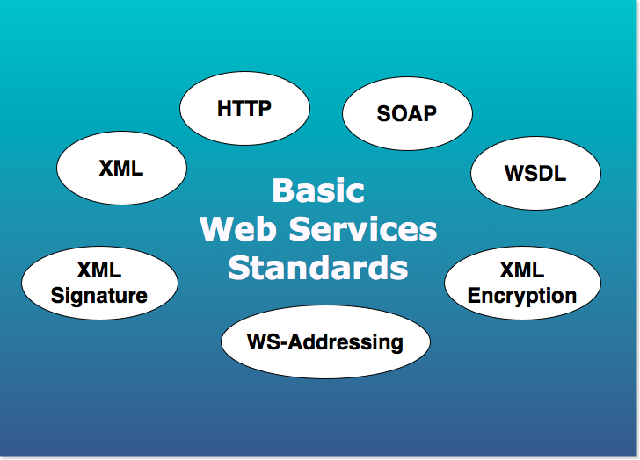
Putting it All Together
Notes:
Developing normative language was challenging due to the amount of complexity introduced by all the various goals of conformance and interoperability.
Basic Industry Standards
Security-Related Industry Standards
Interoperability Profiles
GRA
GFIPM Functional Requirements
GFIPM Federated Service Interaction Models
Implementation Support on Popular Platforms (not shown)

Slide 29
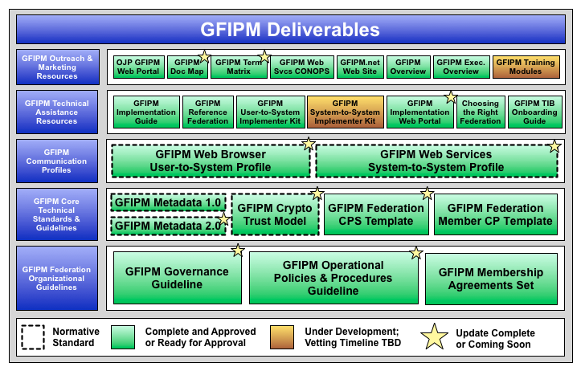
GFIPM Deliverables Landscape
Notes:
All of this work led to the development of a GFIPM Web Services System-to-System Profile.
In addition to meeting all the interoperability and conformance requirements previously discussed, it also had to align with other GFIPM standards and meet GFIPM goals.
It is supported by, and relies on, all normative specs in the layer beneath it.
It is a peer to, and is interoperable with, the GFIPM Web Browser User-to-System Profile.

Slide 30
Current State of GFIPM WS Profile
Currently at version 1.0 DRAFT
  Defines eight (8) SIPs
  Includes normative language for four (4) SIPs
Well-defined connection to GRA
  All SIPs conform to the GRA RS WS-SIP
Scope of normative GFIPM language is clear
  In early drafts, this was not the case
Reviewed by multiple GFIPM stakeholders
  GRA authors, NIEF participants, vendors
Implementable with existing products (Metro, .NET)
Ready for Global review NOW
Notes:
The profile is at version 1.0 DRAFT. It is ready for Global review now.
Of the eight SIPs defined in the profile, only four are fully fleshed out with normative language.
It has been reviewed by many stakeholders. Most reviewers so far have been highly technical, web services experts.
This is important, because this doc is easily the most technically “deep” document that we have produced in the GFIPM program.
The four that are complete are also implementable on the Java Metro 2.2.1 and .NET 3.5 platforms.
We confirmed this through rigorous testing over a period of nearly one year.
Our testing has demonstrated conformance of prototype implementations to the normative language.
We have also demonstrated interoperability between Java Metro 2.2.1 and .NET 3.5.
Our testing has involved a large amount of “green-field” research.
To our knowledge, nobody else has yet discovered or solved many of the basic issues that we have found.
These issues are mostly related to cross-platform interoperability with SAML assertions. We are probably the first to try this.

Slide 31
Normative Language: GFIPM WS SIPs
Consumer-Provider SIP ^{1.0}
User-Consumer-Provider SIP ^{1.0}
Consumer-Provider Session SIP ^{2.0}
User-Consumer-Provider Session SIP ^{2.0}
Authorization Service SIP ^{2.0}
Trusted Identity Broker SIP ^{1.0}
Consumer-Provider Multi-User Session SIP ^{2.0}
SAML Assertion Delegate Service SIP ^{1.0}
Notes:
Here are the eight SIPs that appear in the profile doc.
SIPs marked with a red “2.0” do not yet have normative language.
This includes all SIPs related to sessions, plus the Authorization Service SIP. These are more complex use cases.
We plan to complete the normative language for these SIPs in version 2.0 of this spec. (See next slide.)

Slide 32
GFIPM WS Profile 2.0
Normative language for all eight (8) SIPs
May also include more generic optional language
  Would cover “holes” in SIPs
    E.g. How do I do sessions along with an AS?
    Several likely real-world use cases are still undefined
Target date: TBD
  Requires validation of implementability
Notes:
Version 2.0 of the profile will contain normative language for all eight SIPs.
It may also include a “genericized” version of the normative language that allows for optional use of all features defined by the individual SIPs, as needed.
For example, we currently do not have a SIP that defines how to use an Authorization Service (AS) with a user, or with a session, or both.
These seem to be important real-world use cases, so we will probably need to cover them.
We expect version 2.0 to be complete some time in 2012.
As with version 1.0, we plan to confirm implementability of the normative language, as well as cross-platform interoperability.

Slide 33
GFIPM Deliverables Landscape
Notes:
In the course of developing the GFIPM WS profile, we also needed to make changes to the GFIPM Crypto Trust Model spec.
This spec defines the structure of the GFIPM Crypto Trust Fabric, which is used to bootstrap cryptographic trust in a GFIPM federation.

Slide 34
GFIPM Crypto Trust Model
Version 1.1 (Approved by GAC in 2010)
  Defines Trust Fabric structure
    Profiles the SAML metadata spec
  Defines TF lifecycle mgmt. (creation, distribution)
  Defines standard GFIPM crypto baseline reqs.
Version 2.0 (Ready for Global review now)
  Extends SAML metadata spec to handle WS
    Extends the SAML <md:RoleDescriptor> element
    Handles WSCs, WSPs, etc.
Notes:
The most recent approved version of this spec handles the User-to-System use case only.
It was approved by GAC in 2010.
It is based on the SAML Metadata standard, so it naturally handles only IDPs and SPs.
We modified it to accommodate web services components, by defining a schema extension.
The updated version is ready for Global review now.
What review process is required for document revisions, as opposed to first-time publication of docs?

Slide 35
Full List of GFIPM WS Deliverables
GFIPM WS CONOPS (DONE)
GFIPM WS Profile 1.0 (Ready for Review)
  Goal: Review complete by Spring 2012 GAC mtg.
GFIPM Crypto Trust Model 2.0 (Ready for Review)
Implementer Toolkits (In Progress)
  Downloadable sample code and instructions
  Available for several popular platforms
Reference Services (In Progress)
  Will exist in GFIPM Reference Federation
  Will provide an online testing tool for each SIP
    Implementers can test GFIPM conformance of their code via Internet
Implementation Guidance (TBD/Future)
  Comprehensive documentation on planning, implementing, and deploying GFIPM web services
  Broader in scope than toolkit instructions
  Requires production WS implementation experience
Notes:
Here is the full list of GFIPM web services deliverables.
We have made significant progress so far, but much still remains.
Version 2.0 of the profile
Implementer toolkits – see the “Implementation Status Update” slide deck
Reference services – for interoperability testing
Implementation guidance – broad in scope – more than simply a configuration HOW-TO manual – cannot write it until we gain some experience
To bring these deliverables into “full” maturity, we will need to implement them in production systems.
Are we ready to begin discussing that now?
Are any stakeholder agencies interested in volunteering to do this?

