Slide 1




GFIPM Web Services
Implementation Status Update
GFIPM Delivery Team Meeting
November 2011

Slide 2
GFIPM Web Services Timeline
~2009: Development of use cases / CONOPS
~2010: 1st solid draft of spec – version 0.5
  Reviewed by community WS experts
  Aligned with GRA via Std. Global Package effort
  Aligned with implementation support for standards
~2011: Verified implementability of spec
  Goals:
    Conformance on multiple platforms
    Interoperability between all platforms
  Encountered many impl. challenges
  Led to several normative language changes
  Now at version 1.0 DRAFT
Notes:
This is the historical timeline of GFIPM web services development to date.
We wrote the CONOPS doc throughout 2009.
In 2010 we developed a solid draft web services spec.
It was reviewed by several WS experts, both within Global and by vendors (IBM, Microsoft).
We spent most of 2011 refining the spec and confirming implementability of it.
We used several prominent development platforms: Java Metro, .NET 3.5, and .NET 4.0.
Metro is the most mature and most commonly used Java-based WS platform.
It is open source, and several vendor products (including IBM’s) use it.
Our goals were conformance (i.e. implementability of the spec) and interoperability between platforms.
We encountered many issues and challenges during that process. We will discuss them in the next few slides.
We how have a “1.0 DRAFT” version ready for review by Global.

Slide 3
Conformance and Interoperability:
The Scope of the Challenge (Model #1)
Java Metro WSC
Java Metro WSP
.NET 3.5 WSC
.NET 3.5 WSP
.NET 4.0 WSC
.NET 4.0 WSP
Notes:
The scope of the conformance and interoperability challenge is large.
This diagram depicts all of the relationships that we tested for Federated Service Interaction Model #1.
This model does not include a user.
In the normative language, this model is covered by the GFIPM WS Consumer-Provider SIP.
For every additional platform that we introduce, the scope grows geometrically (n-squared).

Slide 4
Conformance and Interoperability:
The Scope of the Challenge (Model #2)
Java Metro ADS
.NET 3.5 ADS
.NET 4.0 ADS
Java Metro WSC
Java Metro WSP
.NET 3.5 WSC
.NET 3.5 WSP
.NET 4.0 WSC
.NET 4.0 WSP
Notes:
Here is the set of interoperability test cases for Interaction Model #2.
This model includes a user.
In normative language, this model is the GFIPM WS User-Consumer-Provider SIP.
This challenge also grows geometrically, but is (at least) twice as complex as the first one.

Slide 5
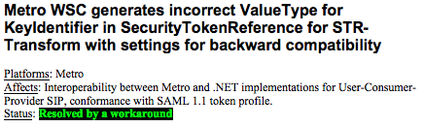
Example Issues Identified
Why does this matter?
➔ Required for secure, interoperable handling of user attributes in WS messages
Notes:
The next few slides illustrate some of the specific issues that we have identified.
These issues involve extremely “deep” technical details.
For each issue, we have tried to summarize why it is important that we fix the problem.
Most of the issues that we will show have been resolved.
Some are still outstanding, and at least one requires a vendor to fix a bug.
This issue is related to the digital signature of a SAML assertion within a SOAP header, on the Metro platform.

Slide 6
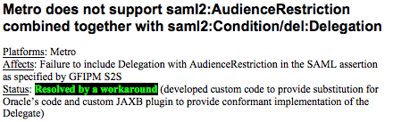
Example Issues Identified
Why does this matter?
➔ Required for secure, interoperable handling of user attributes in WS messages
Notes:
This issue relates to the creation of a delegated SAML assertion by a Metro ADS.
We fixed it with a custom-code workaround.

Slide 7
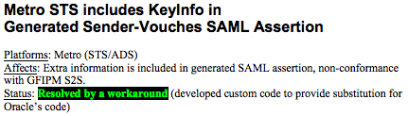
Example Issues Identified
Why does this matter?
➔ Required for secure, interoperable handling of user attributes in WS messages
Notes:
This issue is related to the generation of SAML assertions on a Metro ADS.
We fixed it with a custom-code workaround.

Slide 8
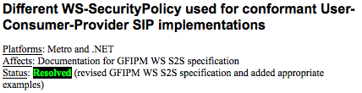
Example Issues Identified
Why does this matter?
➔ Required for specification of platform-independent, GFIPM conformant, standards-based security policies within web service definitions
Notes:
This issue involves the use of WS-SecurityPolicy to expose certain security policy requirements of a WSP.
It is possible to use WS-SecurityPolicy to express many of the normative requirements in the GFIPM WS spec.
In theory, it is possible to use the same WS-SecurityPolicy language for any WSP on any platform.
In practice this is not always possible. We have tweaked the spec and added some examples to illustrate one way – but not necessarily the only way – to express certain requirements.

Slide 9

Example Issues Identified
Why does this matter?
➔ Required for conformance to GRA Reliable Secure WS SIP (interop.)
Notes:
This issue is strictly related to GRA RS WS-SIP conformance.
It has been resolved.

Slide 10
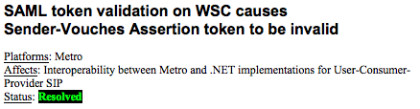
Example Issues Identified
Why does this matter?
➔ Required for secure, interoperable handling of user attributes in WS messages
Notes:
This is a Metro-specific problem related to the XML validation of a SAML assertion within a SOAP header.
We have resolved it.

Slide 11
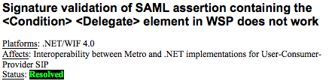
Example Issues Identified
Why does this matter?
➔ Required for secure, interoperable handling of user attributes in WS messages
Notes:
This is a signature validation problem within a .NET 4.0 WSP.
It manifests whenever the Delegate element appears in a SAML assertion.
This happens for every SAML assertion in GFIPM web services.
We have resolved it.

Slide 12
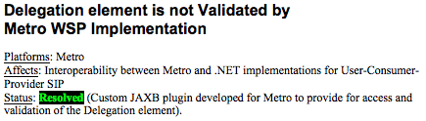
Example Issues Identified
Why does this matter?
➔ Required for secure, interoperable handling of user attributes in WS messages
Notes:
The Metro WSP was not validating the SAML Delegate element in SAML assertions.
We have resolved it via development of a custom plugin.

Slide 13
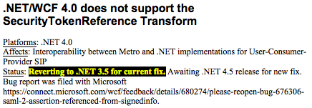
Example Issues Identified
Why does this matter?
➔ Required for secure, interoperable handling of user attributes in WS messages
Notes:
This is an outstanding issue that manifests in all .NET 4.0 web services endpoints.
.NET 4.0 violates the WS-Security SAML Token Profile (version 1.1) by not supporting a “Security Token Reference Transform”.
It works OK as long as both endpoints use .NET 4.0.
This is a showstopper for interoperability between .NET 4.0 and any other platform.
We have notified Microsoft of the problem.
This problem existed in .NET 3.5, but has been patched.
It reappeared in .NET 4.0.
Microsoft does not plan to issue a patch for .NET 4.0 in the near future, but will fix it in .NET 4.5.
We will provide support for GFIPM web services on .NET 4.5 when it is released.
GFIPM support for .NET 4.0 is TBD, pending action by Microsoft.

Slide 14
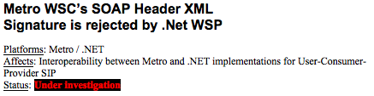
Example Issues Identified
Why does this matter?
➔ Required to prevent replay attacks using SAML assertions for GFIPM users
Notes:
This is a digital signature interoperability problem between Metro and .NET.
It manifests when a SAML assertion is included in the SOAP header.
We need to fix this, because a SAML assertion must be cryptographically bound to the SOAP header of the message in which it is used.
If not, then it would be possible in theory to reuse the SAML assertion in a replay attack against the user.
It is still under investigation.

Slide 15
Current Status
Version 1.0 of spec ready for review
  Implementability confirmed on multiple platforms
Significant implementation experience
  Java Metro, .NET 3.5, .NET 4.0
  Achieved interoperability across platforms
    Validated all SIPs that have normative language in v. 1.0 of spec
    Metro and .NET 3.5: close to full interoperability
    Problem with .NET 4.0 (on hold pending MS patch)
    Plan to support .NET 4.5 when available
Implementer tools in development now
  Implementer toolkits and libraries
  Reference services in GFIPM Ref. Federation
  Implementer documentation
Notes:
We have full interoperability between Metro, .NET 3.5, and .NET 4.0 for Model #1 (without user).
Aside from the outstanding issues on the previous two slides, we have achieved full interoperability between Metro and .NET 3.5 for Model #2 (with user.)
We have confirmed that .NET 4.0 cannot interoperate with .NET 3.5 or Metro for Model #2 unless MS issues a patch.
Our next step is to develop implementer tools based on the prototypes that we have developed, for .NET 3.5 and Metro.

Slide 16
Implementer Integration Points (IIPs)
(Conceptual – NOT the Actual APIs)
GFIPM User-to-System Use Case IIPs
  Single Sign-On IIP (at IDP)
  Attribute Repository IIP (at IDP)
  Protected Resource IIP (at SP)
GFIPM System-to-System Use Case IIPs
  Data Payload IIP (at WSC and WSP)
  Authorization IIP (at WSP)
  SAML ADS IIP (at WSC)
  Trust Fabric IIP (at WSC, WSP, and ADS)
Notes:
When we started the GFIPM demo project in 2006, we identified three conceptual integration points that any implementer must address in the U-to-S use case.
SSO IIP: Integrates with existing authentication system for the implementing agency’s users
Attribute Repository IIP: Allows the IDP to look up source attribute data for generating SAML assertions
Protected Resource IIP: Allows the implementer to “GFIPM-Enable” protected resources.
This is the process of enabling the resource or application to use SAML assertions as the basis for access control decisions.
In the S-to-S use case, there are similar logical, conceptual IIPs.
Note that these are NOT the actual APIs. The API details differ by platform.

Slide 17
Data Payload IIP
WSC/WSP implementers must bind the data payload (e.g. NIEM IEPD) to the GFIPM layer
Closely tied to WSDL interface
  “Contract-First Development”
WSC: Provide stubs that map to WSDL ifc.
WSP: Provide handler/callback stubs for implementing WSDL ifc. methods
The payload itself is out of GFIPM scope
Notes:
Both the WSC and the WSP must have a “Data Payload IIP”.
This enables the implementer to bind the data payload to the GFIPM secure transport mechanism.
This IIP is literally where the NIEM IEPD meets GFIPM.
The WSC must provide stubs to the WSP’s WSDL interface.
The WSP must provide callback stubs for implementing the content-related application logic.

Slide 18
Authorization IIP
WSP developer must implement access control logic for exposed services
Authz. IIP must provide hooks into attr. sources
  User attributes → SAML Assertion
  Entity attributes of WSC → Trust Fabric
Future work: integrate with XACML framework
  Enable WSP to act as XACML PEP
Notes:
The WSP must have an integration point through which the implementer can implement access control logic.
Currently, this IIP includes interfaces that allow the implementer to look up attributes about the WSC and the user.
WSC’s entity attributes are in the Trust Fabric.
User’s attributes are in the SAML assertion.
We are working on a more advanced framework for privacy and authorization, based on XACML.
XACML = eXtensible Access Control Markup Language
Framework includes terms such as PDP, PEP, etc.
The goal of this framework is to externalize access control policy, i.e. factor it out of application source code.
We have built a prototype GFIPM web services that uses this framework.

Slide 19
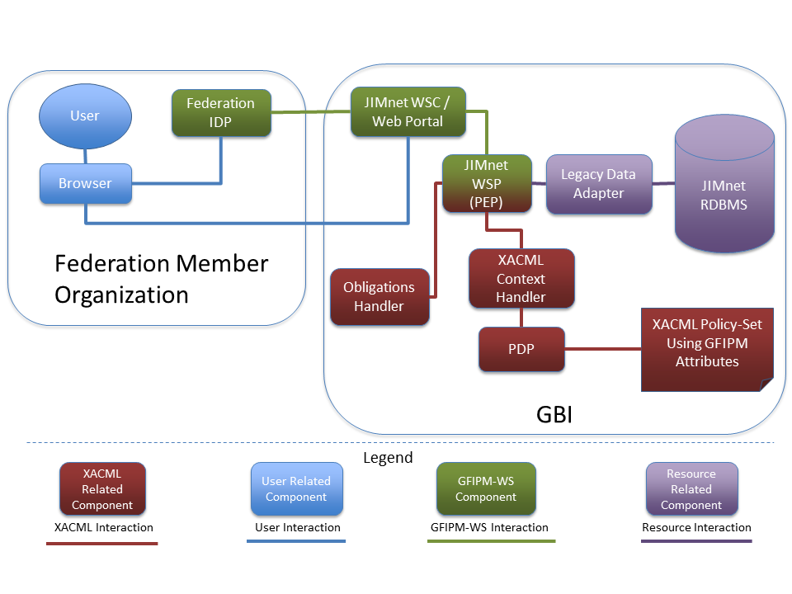
Web Services / XACML
Integration Example: GBI JIMnet
Notes:
We developed a prototype of GBI JIMnet that uses GFIPM web services and a XACML framework.
This work was funded by BJA through the National Center for State Courts.
This diagram depicts the architecture of the prototype.
Note that the WSP acts as a XACML PEP, and exists within a broader enterprise XACML framework.
We will talk more about this project during a later session.

Slide 20
SAML Assertion Delegate Service
Co-located with IDP
Transforms one SAML assertion into another
  Changes “Audience Restriction” and “Subject Confirmation Method”
  Adds “Delegate” info (preserves delegate chain)
Re-signs new assertion with IDP’s private key
Does NOT require access to IDP’s attribute data store
  Minimal integration with existing IDP
  No software changes required / config. only
Notes:
We have already discussed the need for an ADS.
Required for conformance to SAML assertion processing rules. (No assertion forwarding is permitted.)
Any GFIPM WS transaction that is performed on a user’s behalf must involve the issuance of a SAML assertion by an ADS.
An ADS is always co-located with an IDP. It serves much the same purpose as an IDP.
We have designed the normative ADS language to NOT require that an ADS have access to the IDP’s attribute store.
This was a practical decision, intended to keep the ADS as lightweight and easy to deploy as possible.
Because of this, the ADS can only revise and re-sign existing assertions. It CANNOT create new assertions.

Slide 21

Example of Nesting/Chaining with ADS
Each relying party requires a new SAML assertion
CISA
FBI CJIS
LAC
RISS IDP
RISS ADS
1
RISS User
5
2
3
9
CISA APP (WSC)
CJIS Fed. Query Svc.
FBI CJIS WSP
FBI CJIS WSC
6
LAC WSP
4
8
7
Notes:
This is an example of how GFIPM web services actually work, in the case where a SAML assertion must be “forwarded”.
It depicts a RISS user accessing a CISA application, which accesses an FBI CJIS query service, which queries multiple data sources.
At each successive step, the WSC must return to the user’s ADS and get a new assertion targeted towards the appropriate WSP.

Slide 22
SAML ADS IIP
WSC must acquire the “right” SAML assertion for each WSP
  Transform one SAML assertion into another
Must contact the “right” ADS for each user
  Equivalent to “calling back” to the user’s IDP
  Receives SAML assertion from the right IDP, for the right WSP
WSC-side processing logic can be transparent to the app developer
Notes:
We plan to abstract away as much ADS detail as possible from the WSC, to relive the application developer of this burden.
This includes abstracting away the identification of the appropriate ADS and dispatching to the ADS.
Details are TBD.

Slide 23
Trust Fabric IIP
Secure web svcs. typically use a traditional local certificate store
GFIPM WS endpoints must use trust fabric
  Defines which endpoints are trustworthy
  No native support in COTS WS products
Trust Fabric IIP provides “glue” between local cert store and trust fabric
  Manages TF updates: cert addition, removal
    Syncs local cert store with latest TF state
  Handles entity attribute lookup
    Used by WSP for authz decisions
Notes:
All GFIPM web services require the use of GFIPM Trust Fabric.
At any given time, the latest version of the TF defines the current list of trusted agencies and systems within the federation.
None of the major web services platforms support the Trust Fabric concept.
They support a more traditional local certificate store concept.
We need to provide tools that allow GFIPM TF to be consumed and used seamlessly on these platforms.
We have already prototyped these tools.

Slide 24
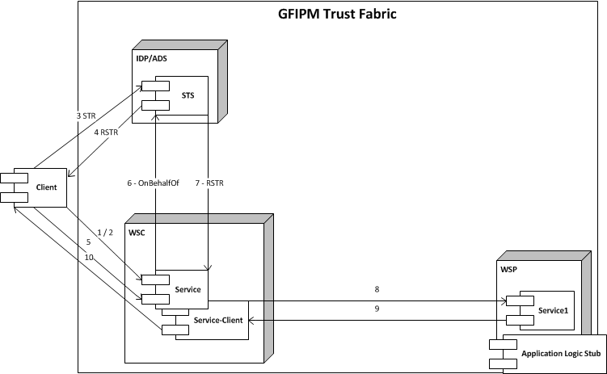
More Detail: IIP

Slide 25
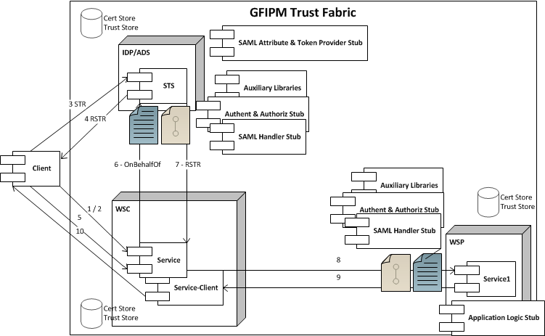
More Detail: IIP

Slide 26
More Detail: IIP
GFIPM Trust Fabric

Slide 27
More Detail: IIP
  Service Contract
  WS-Policy templates
  Service Contract
  WS-Policy templates

Slide 28
More Detail: IIP
SAML Token Provider sample stub
SAML Attribute Provider sample stub

Slide 29
More Detail: IIP
SAML Assertion validation stub
SAML Assertion attribute PEP/PDP stub
SAML Assertion handling stubs
SAML Assertion validation stub
SAML Assertion attribute PEP/PDP stub
SAML Assertion handling stubs

Slide 30
More Detail: IIP
GFIPM Specific Code
Workarounds, bug fixes
GFIPM Specific Code
Workarounds, bug fixes

Slide 31
Timeline for Implementer Tools
Java Metro and .NET 3.5 Toolkits and Documentation for Spec version 1.0
  Spring 2012 GAC Mtg.
Reference Services in GFIPM Ref. Federation for Spec version 1.0
  Spring 2012 GAC Mtg.
.NET 4.0 Toolkit and Documentation for v. 1.0
  TBD / On hold pending MS patch to .NET 4.0
.NET 4.5 Toolkit and Documentation for v. 1.0
  TBD / Depends on availability of .NET 4.5

