Slide 1
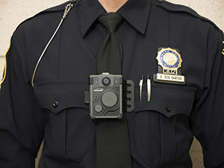
Initial Findings from Newark’s Body-Worn Camera Officer Surveys
Western Society of Criminology
February 9, 2019
Leigh Grossman, Ph.D. – Rutgers University

Slide 2
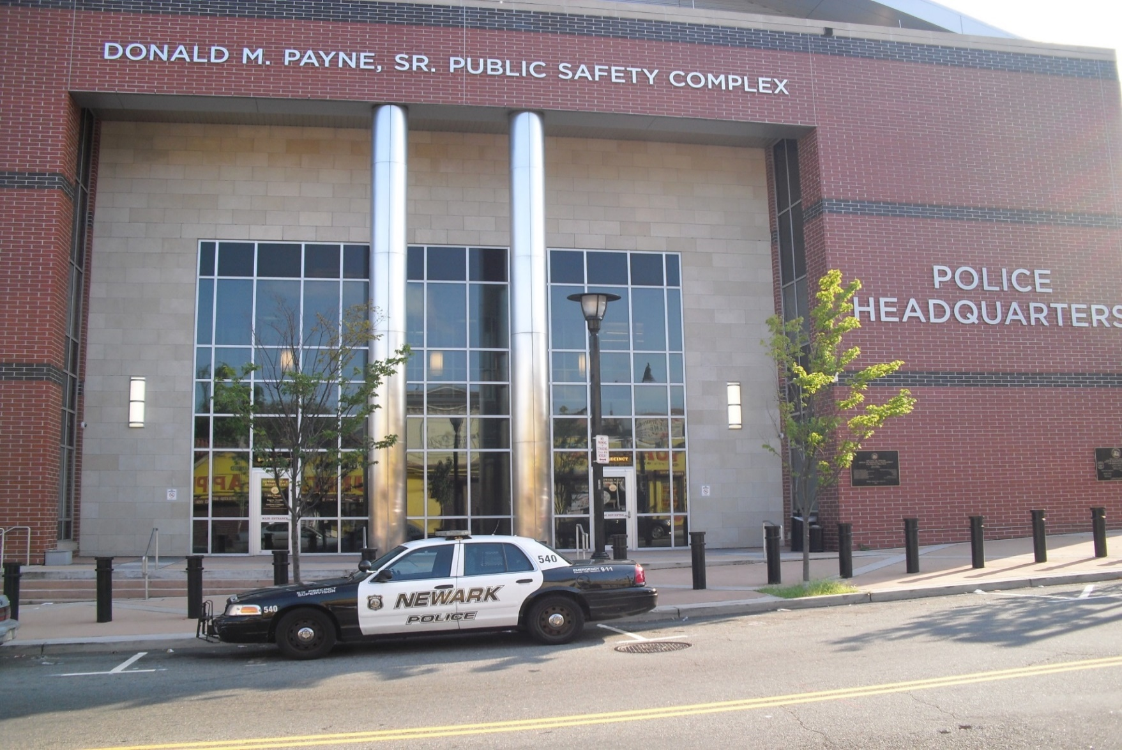
Overview
Body-Worn Camera (BWC) Overview
NPD BWC Program & Research Setting
Current Study
  Survey Methods
  Demographics
  Frequency Tables
  Logistic Regression
Next Steps
2

Slide 3
Body-Worn Camera (BWC) Overview
National discourse and public sentiment in favor of implementation
(Jennings, Lynch, and Fridell, 2015)
Interim Report of the President’s Task Force on 21st Century Policing
  Call for and funding of BWCs
  Followed high profile shootings
Perceived benefits include reducing use of force and complaints against officers, enhancing police legitimacy and transparency, improving evidence captured by the police (Ariel, Farrar, and Sutherland, 2015; Crow, Snyder, Crichlow, and Smykla, 2017)
  BWCs may enhance procedural justice, but that is only one aspect of what affects overall perceptions of police legitimacy
3
Notes:
Due to a number of high profile events which resulted in deaths of often unarmed individuals, the public outcry for BWCs has been at its peak for the past couple of years.
In 2015, the Interim Report of the Presidents Task force on 21st century policing was released. Mentioned in it was the way technology is changing the relationship between the community and the police. Advocated for the careful implementation of BWCs using the BJAs toolkit
The perceived benefits of BWCs include reduced use of force incidents, reduced complaints against officers, enhanced legitimacy and transparency. Evaluations of these benefits have been mixed. Some studies found significant reductions in complaints; while others found no differences

Slide 4
Newark Police Division’s Body Worn Camera Program
Newark is the largest city in the state of New Jersey with approximately 277,000 residents.
  Over half of the population is African American, 29% live below the poverty line.
  Approximately 1,050 sworn officers, 400-450 in patrol
In 2016, the City of Newark entered into consent decree with the Department of Justice after an investigation found a pattern and practice of unconstitutional policing.
  One of the requirements of the consent decree was to begin using body worn cameras on patrol officers.
NPD applied for and received a grant under the BJA’s Body-Worn Camera Policy and Implementation Program to help them purchase cameras
  Also included an evaluation by Rutgers University
4
Notes:
Leigh:
Located approximately 20 minutes outside of New York City.
The investigation focused on allegations of excessive force, unconstitutional stops, searches and seizures; discriminatory policing
-found that approximately 75% of pedestrian stops provided insufficient constitutional basis for the stop
-pattern or practice of unconstitutional arrests for behavior perceived as insubordinate or disrespectful to officers
-significant underreporting of use of force by officers
-inadequate supervision and training which contributed to the problems
-Majority of money to go towards the cameras. Simple evaluation that looked at arrests, field interviews, internal affairs complaints, use of force reports, incidents called-in by officers, assaults on officers.

Slide 5
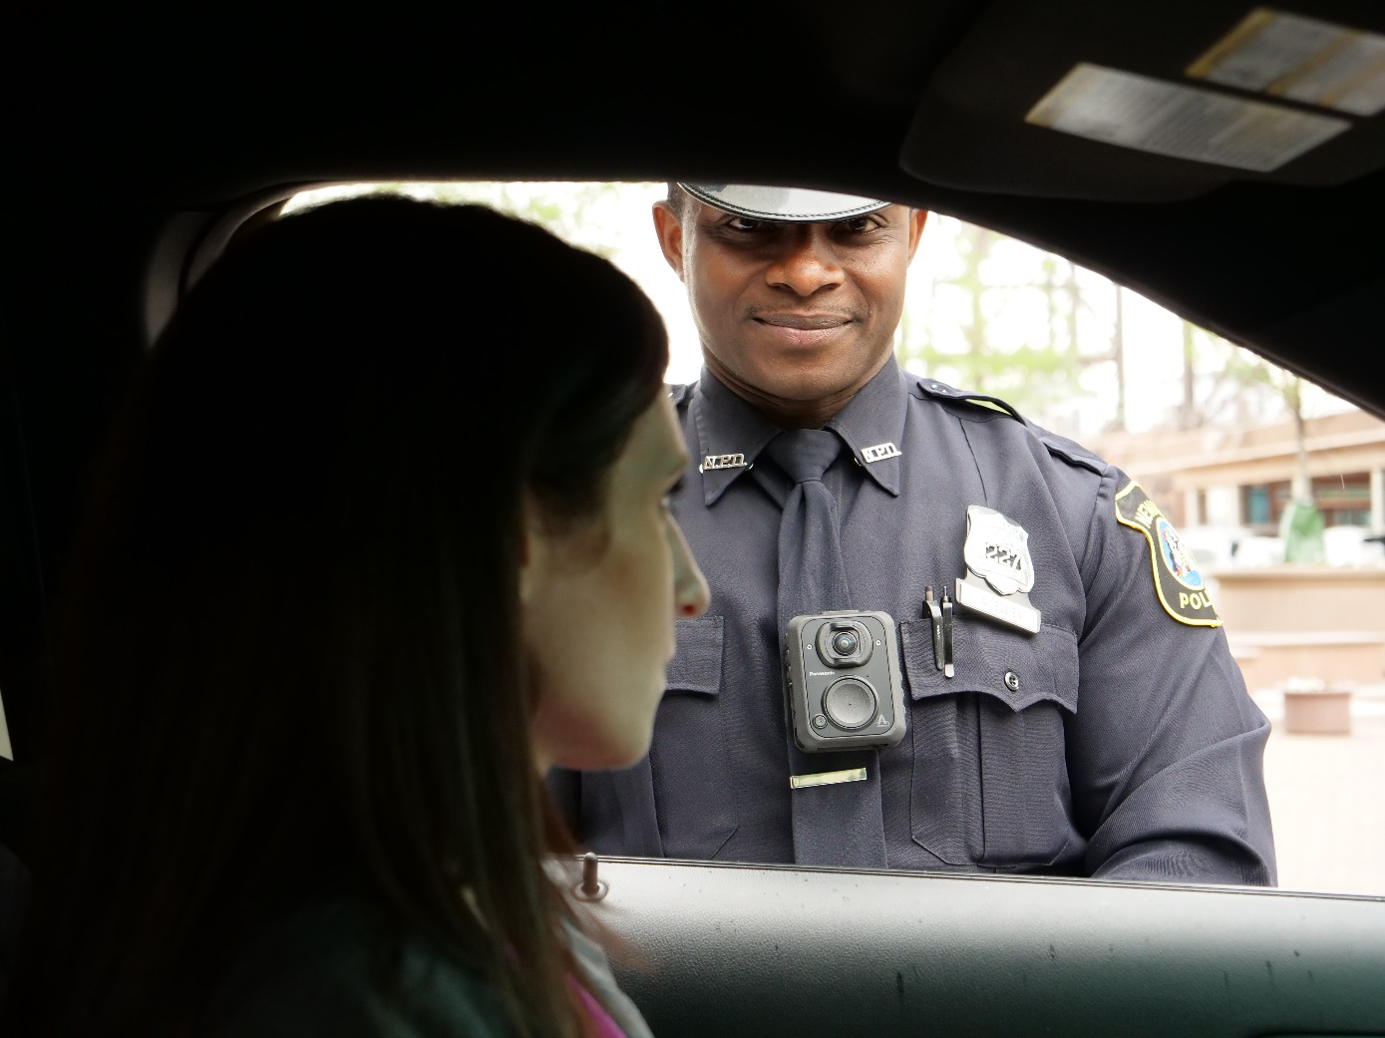
Newark Police Division’s Body Worn Camera Program
The NPD agreed to a precinct by precinct rollout of the cameras for patrol officers.
  One month gap between full rollout in one precinct and the beginning of rollout in another precinct.
Full rollout was initially estimated for January 2018.
  Computer Virus
  Connectivity Issues
Full rollout for precincts completed
December 14, 2018
5
Notes:
Leigh:
-Rutgers initially proposed a randomized control design but learned that there would be too much contamination between officers with and without cameras.
-Agreed to a precinct by precinct rollout which would allow us to compare similar precincts. Rollout was supposed to be configured so there would be a three month gap between comparison precincts.
-Lots of technological issues which delayed rollout. Issues with uploading to the server, issues linking the dash camera and the body camera
-These delays led the PD to disregard the rollout plan and implement as fast as possible so they could meet full rollout by early 2018.

Slide 6
Survey Methods
Each patrol officer was provided a officer survey once their policy training was completed
Surveys were anonymous and collected by the instructor at then end of the class.
Surveys consisted of six demographic questions and 16 BWC questions
  Gauged perceptions of police/community relations, officer safety, releasing BWC footage, overall opinions, etc.

Slide 7
Demographic Information
61.5% of patrol officers had less than five years on the job
  45.8% of these officers were brand new and just graduated the academy
30% of respondents identified as Black, 49% Hispanic, 16% White, and 5% Other
82% of respondents were male, 18% female
Age
  18 to 25: 25.6%
  26-35: 39.5%
  36-45: 15.1%
  46+: 19.8%
60.2% of respondents live in Newark

Slide 8
Frequency Tables
 | Very Strongly Disagree | Strongly Disagree | Disagree | Agree | Strongly Agree | Very Strongly Agree
BWCs Improve Police/Community Relations | 10.85% | 6.24% | 16.4% | 27.71% | 18.71% | 20.09%
Citizens will be more cooperative | 12.98% | 10.02% | 19.13% | 27.79% | 15.72% | 14.35%
Officers will act more professional | 5.52% | 2.76% | 8.97% | 20.46% | 25.75% | 36.55%
Suspects are less likely to resist | 28.54% | 13.93% | 19.86% | 19.63% | 10.05% | 7.99%
BWCs will decrease citizen complaints | 13.79% | 8.28% | 16.55% | 22.76% | 19.54% | 19.08%
Notes:
-67% of officers feel BWCS will improve police community relations
-most believe officers will act more professional
-Most do not believe that they will make suspects less likely to resist
-majority believe that BWCs will decrease citizen complaints

Slide 9
Frequency Tables
 | Very Strongly Disagree | Strongly Disagree | Disagree | Agree | Strongly Agree | Very Strongly Agree
All footage should be made public | 32.49% | 16.7% | 16.02% | 14.8% | 8.01% | 11.9%
Only critical incidents made public | 12.81% | 5.95% | 11.21% | 18.99% | 25.4% | 25.63%
Officers less likely to give warnings | 13.99% | 8.72% | 16.97% | 22.48% | 16.74% | 21.1%
Officers will be less proactive | 22.45% | 12.96% | 19.21% | 20.37% | 10.65% | 14.35%
Officers will respond to fewer CFS | 47.73% | 18.41% | 14.55% | 10.91% | 2.95% | 5.45%
Notes:
-Most officers disagree that all footage should be made public but agree that only critical incidents should be made public
-most believe that there will be less discretion with BWCs
-most disagree that officers will respond to fewer CFS

Slide 10
Frequency Tables
 | Very Strongly Disagree | Strongly Disagree | Disagree | Agree | Strongly Agree | Very Strongly Agree
Less likely to use force even when necessary | 16.82% | 12.67% | 15.67% | 22.58% | 16.36% | 15.9%
NPD officers have favorable opinion | 14.42% | 10.98% | 19.68% | 32.49% | 11.21% | 11.21%
BWCs increase officer safety | 13.9% | 5.92% | 12.76% | 23.23% | 16.86% | 27.33%
All patrol officers should wear | 12.41% | 5.52% | 14.25% | 22.07% | 16.55% | 29.2%
Specialized units should wear | 24.49% | 9.15% | 14.42% | 18.08% | 10.98% | 22.88%
Advantages outweigh disadvantages | 11.03% | 4.6% | 16.32% | 29.89% | 17.47% | 20.69%
Notes:
-no real consensus on whether officers will be less likely to use force even when necessary
-Also split on whether NPD officers view BWCs favorably
-Majority believe they increase officer safety
-Majority also believe that all patrol officers should wear
-Split on whether specialized units should wear
-Majority agree that the advantages outweigh the disadvantages

Slide 11
Logistic Regression
Independent variables
  Experience
    Less than 5 years, 5 years or more
  Race
    Black, White, Hispanic
  Gender
    Male, female
  Age
    18-25, 26-35, 36-45, 46+
  Residency
    Lives in Newark, doesn’t live in Newark
Dependent variables reclassified to binary variables: agree/disagree
Odds ratios calculated to facilitate the interpretation of results

Slide 12
Officer Safety
----------------------------------------------------------------------------------
BIIncreasOffSafe | Odds Ratio Std. Err. z P>|z| [95% Conf. Interval]
-----------------+----------------------------------------------------------------
LessThan5Years | 2.91783 1.3803 2.26 0.024 1.154498 7.374401
Hispanic | 2.221071 .6202862 2.86 0.004 1.284827 3.839551
Black | 1.600274 .4935919 1.52 0.127 .8742751 2.929144
Male | .3219599 .118539 -3.08 0.002 .1564614 .6625163
Age26to35 | 1.006333 .2844007 0.02 0.982 .5783395 1.751058
Age36to45 | 1.406488 .7688444 0.62 0.533 .4817639 4.106179
Age46Plus | 3.786195 2.154143 2.34 0.019 1.241408 11.54759
LivesinNewark | .9589723 .2565619 -0.16 0.876 .5676452 1.620075
_cons | 1.260959 .7812774 0.37 0.708 .3743737 4.247142
----------------------------------------------------------------------------------
Less experience, more likely to believe BWCs increase officer safety
Hispanic officers more likely to believe increase officer safety
Males less likely to believe BWCs will increase officer safety
Notes:
Compared to officers with 5 years or more of experience, officers with less experience are 190% more likely to believe that BWCs will increase officer safety. Compared to Whites, Hispanics are 120% more likely to feel that BWCs will increase officer safety. Compared to females, male officers are 68% less likely to believe the cameras will increase officer safety

Slide 13
Make All Footage Public
---------------------------------------------------------------------------------
BIAllFootPublic | Odds Ratio Std. Err. z P>|z| [95% Conf. Interval]
----------------+----------------------------------------------------------------
LessThan5Years | .9196808 .4348181 -0.18 0.859 .3640789 2.323158
Hispanic | 1.908867 .5757013 2.14 0.032 1.056962 3.447405
Black | 1.97432 .6500517 2.07 0.039 1.035515 3.764251
Male | 1.80706 .5659187 1.89 0.059 .9781396 3.338444
Age26to35 | .7968205 .2166623 -0.84 0.404 .4676399 1.357718
Age36to45 | .5048614 .2838799 -1.22 0.224 .1677057 1.519835
Age46Plus | 1.679859 .9215049 0.95 0.344 .5732406 4.92276
LivesinNewark | 1.16962 .3083818 0.59 0.552 .6976167 1.960976
_cons | .2012696 .1272894 -2.53 0.011 .0582708 .695193
---------------------------------------------------------------------------------
Hispanic and Black officers are more likely to believe that all BWC footage should be made public compared to White officers.
Notes:
Compared to white officers, Hispanic and Black officers were 91% and 97% more likely to believe that all BWC footage should be made public
For making only critical incidents public, there were no significant differences between officers

Slide 14
Officers Less Proactive
---------------------------------------------------------------------------------
BILessProactive | Odds Ratio Std. Err. z P>|z| [95% Conf. Interval]
----------------+----------------------------------------------------------------
LessThan5Years | .3443415 .1621895 -2.26 0.024 .1367924 .8667958
Hispanic | .5907377 .1667232 -1.87 0.062 .3397512 1.027137
Black | .9204649 .2877076 -0.27 0.791 .4988261 1.698499
Male | 2.131734 .6530117 2.47 0.013 1.16946 3.885802
Age26to35 | 1.305657 .359811 0.97 0.333 .7607748 2.240794
Age36to45 | .853361 .4685561 -0.29 0.773 .2909125 2.503244
Age46Plus | .8592131 .4813487 -0.27 0.787 .2865764 2.576092
LivesinNewark | .5833999 .1472603 -2.13 0.033 .35572 .9568072
_cons | 1.515394 .9366729 0.67 0.501 .4512251 5.089295
---------------------------------------------------------------------------------
Officers with less experience and officers who life in Newark are less likely to believe that BWCs will make officers less proactive
Male officers are more likely to believe that BWCs will make officers less proactive
Notes:
Compared to officers with more experience, officers with less than five years experience are 76% less likely to believe that BWCs will make officers less proactive.
Similarly, officers that live in Newark are 42% less likely to feel that BWCs will make officers less proactive.
Compared to female officers, male officers are 113% more likely to believe that BWCs will make officers less proactive.

Slide 15
Officers in Specialized Units Should Wear
--------------------------------------------------------------------------------
BISpecWear | Odds Ratio Std. Err. z P>|z| [95% Conf. Interval]
---------------+----------------------------------------------------------------
LessThan5Years | .6297549 .2864364 -1.02 0.309 .2582337 1.535784
Hispanic | 2.02505 .5719691 2.50 0.012 1.164171 3.522533
Black | 2.083502 .6515532 2.35 0.019 1.128771 3.845757
Male | .5117089 .1536076 -2.23 0.026 .2841219 .9215977
Age26to35 | .8873708 .236059 -0.45 0.653 .5268269 1.49466
Age36to45 | 2.164939 1.1489 1.46 0.146 .7651139 6.125833
Age46Plus | 1.948546 1.046185 1.24 0.214 .6802933 5.581171
LivesinNewark | 2.242914 .60404 3.00 0.003 1.323047 3.802332
_cons | .7084208 .4255025 -0.57 0.566 .2182879 2.299074
Black and Hispanic officers more likely to believe that specialized units should wear BWCs compared to White officers.
Officers that live in Newark were more likely to believe that specialized units should wear.
Male officers were less likely to believe that specialized units should wear BWCs
Notes:
Compared to white officers, black and hispanic officers were 108% and 103% more likely to believe that specialized units should wear BWCs.
Officers that live in Newark were also 124% ore likely to believe specialized units should wear.
Alternatively, male officers are 49% less likely to believe that specialized units should wear BWCs compared to women.

Slide 16
Advantages Outweigh Disadvantages
---------------------------------------------------------------------------------
BIAdvanOutweigh | Odds Ratio Std. Err. z P>|z| [95% Conf. Interval]
----------------+----------------------------------------------------------------
LessThan5Years | 3.232929 1.628313 2.33 0.020 1.204691 8.675941
Hispanic | 1.872288 .5150471 2.28 0.023 1.091983 3.21018
Black | 2.534324 .803326 2.93 0.003 1.361601 4.717096
Male | .7516824 .2413746 -0.89 0.374 .4005926 1.410476
Age26to35 | 1.12222 .3125102 0.41 0.679 .6501888 1.93694
Age36to45 | 4.422567 2.630979 2.50 0.012 1.378147 14.19231
Age46Plus | 4.120489 2.422513 2.41 0.016 1.301702 13.04326
LivesinNewark | 1.041632 .2768755 0.15 0.878 .6186672 1.753766
_cons | .4101575 .259843 -1.41 0.159 .1184943 1.419724
Officers with less experience, Black officers, and Hispanic officers are more likely to believe advantages outweigh disadvantages
Older officers are more likely than officers 18-25 to believe that the advantages outweigh the disadvantages
Notes:
Compared to officers with more experience, officers with less than 5 years experience are 223% more likely to believe that the advantages outweigh the disadvantages.
Additionally, Black officers and Hispanic officers are 153% and 87% more likely than white officers to believe that the advantages outweigh the differences.
Finally, older officers age 36 to 45 and 46+ are more than 300% more likely to believe that the advantages outweigh the disadvantages compared to officers 25 years and younger.

Slide 17
Officer Comments
“They are more likely to get a police officer in trouble because even if physical force is necessary, it never looks good on video. A criminal is going to break the law/resist arrest regardless of BWC being present.” WM 25 yrs old, new officer
“They can be positive, but they will make the job more difficult due to the fact people will be more prone to give you a hard time and challenge you on camera trying to exercise their rights.” 30 yrs old, 5 years experience
“Good for patrol units answering dispatched calls. Bad for specialized units who need to be able to speak to people more freely to gain intel, CIS, etc.” WM 28 yrs old, 5 years experience
“They are going to get people in trouble for nonsense, like small talk for example.” WM 25 yrs old, new officer

Slide 18
Next Steps
Post implementation survey six months after full implementation. Patrol implementation completed 12/14/2018
Analyze officer activity
  Measures of officer activity: arrests, field interviews, calls for service, proactive actions
Review use of force and complaint data
  339 citizen complaints in 2018
    86 captured on BWCs
      33 exonerated (38%)
      20 sustained (23%)

