Slide 1
Global Justice Information
Sharing Initiative

Slide 2
Overview
The Global Justice Information Sharing Initiative (Global) operates under the auspices of the Office of Justice Programs (OJP), U.S. Department of Justice
Global advises the federal government, specifically through the Assistant Attorney General, OJP, and the U.S. Attorney General, on justice information sharing and integration initiatives

Slide 3
Global Advisory Committee
To help steer and facilitate Global efforts, the U.S. Attorney General reached out to key personnel from local, state, tribal, federal, and international justice entities to form the Global Advisory Committee (GAC)
The GAC works collaboratively to address the policy, connectivity, and jurisdictional issues that have hampered effective justice information sharing

Slide 4
Global Advisory Committee (continued)
The GAC membership reflects the Global tenet that the entire justice community must be involved in information exchange
Experts represent the following constituencies
Law enforcement agencies
Prosecutors, public defenders, and courts
Corrections agencies
Probation and parole departments

Slide 5
Global Working Groups
GAC efforts focus on defining core justice information sharing requirements and identifying information sharing challenges
GAC working groups, comprised of committee members and other subject-matter experts, expand the GAC’s knowledge and experience

Slide 6
Global Security Working Group
Maintains that security of the entire information exchange enterprise is only as strong as the weakest link
Pursues security measures for today’s enhanced information sharing abilities
Emphasis on determining effective security standards for legacy networks/systems as well as the new and enhanced networks and systems to which they are joined

Slide 7
Global Privacy and Information Quality Working Group (GPIQWG)
Concentrates on issues of
Information privacy
Criminal history records
Criminal intelligence information
Juvenile justice information
Civil justice information

Slide 8
GPIQWG (continued)
Produces privacy policy guidelines and practical templates for implementing privacy practices

Slide 9
Global Infrastructure/Standards Working Group (GISWG)
Successful data exchange is greatly facilitated by the development and adoption of standards that enable transparent integration of disparate systems
GISWG is implementing a coordination process to identify information sharing standards within the justice community

Slide 10
GISWG (continued)
This effort includes publishing, cataloging, and sharing these standards to promote collaborative efforts and offer blueprints to those beginning the information exchange planning process

Slide 11
Global Intelligence Working Group (GIWG)
Formed to serve as the Criminal Intelligence Coordinating Council as described in the “Criminal Intelligence Sharing: A National Plan for Intelligence-Led Policing at the Local, State, and Federal Levels—Recommendations from the IACP Intelligence Summit”

Slide 12
GIWG (continued)
Goals
Seamless sharing of intelligence information between systems
Allow access to information throughout the law enforcement and public safety communities
Develop an Intelligence Sharing Plan
Define ideals of intelligence sharing

Slide 13
GIWG (continued)
Goals (continued)
Develop model principles and policies
Determine training needs
Create an outreach plan to inform the law enforcement and public safety communities of the results of this effort

Slide 14
Global Products
Global Justice XML Data Model
Global Justice XML Flash Demo
The National Criminal Intelligence Sharing Plan
Applying Security Practices to Justice Information Sharing
Global Justice Standards Clearinghouse
Global Justice Information Sharing Initiative Web site
Global Justice Information Products
Global brochure
Global presentations
Global CD-ROMs

Slide 15
Global Reports
2003 annual report to the U.S. Attorney General
Working group reports
Reports on the progress, initiatives, and/or products of the working groups
Meeting minutes
Global Advisory Committee
Global Working Groups

Slide 16
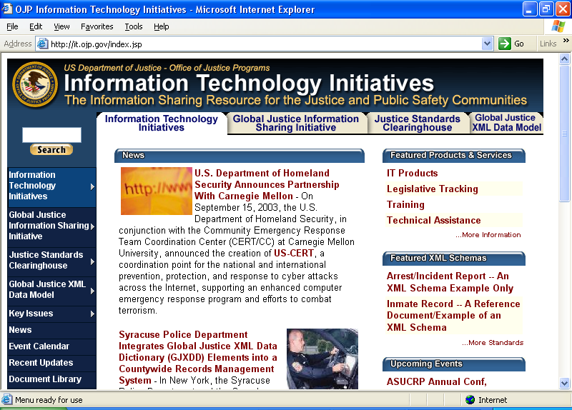
www.it.ojp.gov– Web Site
Content development for the OJP IT and Global Web sites
Web site enables justice agencies to obtain timely and useful information on computer system integration processes, initiatives, and technology developments

Slide 17
www.it.ojp.gov – Web Site (continued)
Resources
Information systems integration efforts
Integration profiles
Best practices
Funding approaches
System descriptions
Telecommunications approaches
Model integrated systems

