Slide 1


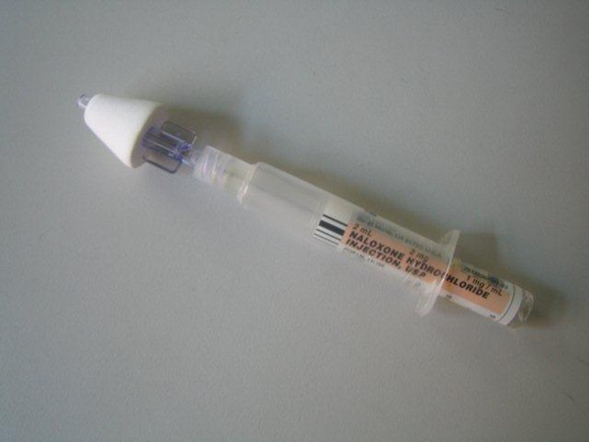
NYPD
NALOXONE TRAINING
PROGRAM

Slide 2
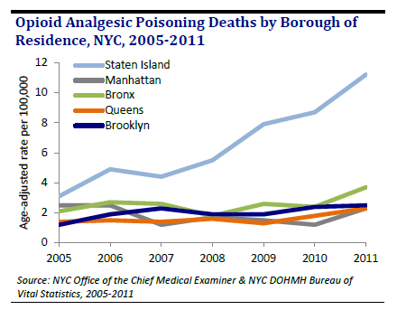
WHY STATEN ISLAND?
.
Opioid overdose death rate is 4 TIMES HIGHER on Staten Island than elsewhere in New York City

Slide 3
WHY ARE YOU BEING ISSUED NALOXONE?
Drug poisoning is now the leading cause of injury death. Naloxone can save a life, and that life might be your family member!
  Children are curious. They can accidently overdose on an adult’s prescription medicine.
  Anyone, including members of the service and their families, can take a dangerous dose of prescription painkillers.
Opioids are involved in more NYC overdose deaths than any other single drug type
Naloxone reverses the potentially fatal effects of opioids on the nervous system
NALOXONE SAVES LIVES

Slide 4
OPIOID OVERDOSE PHYSIOLOGY
Opioids repress the urge to breath, leading to respiratory depression and death
  Slow breathing Breathing stops Heart stops Circulation of blood to the brain stops
Generally happens over course of 1-3 hours. The stereotype “needle in the arm” death only occurs in about 15% of overdose deaths.
Notes:
The key is that there is time to respond to an overdose

Slide 5
SIGNS OF AN OPIOD OVERDOSE
Slow breathing or difficulty breathing
Loud snoring
Blue or grey lips, nail beds
Unresponsive

Slide 6
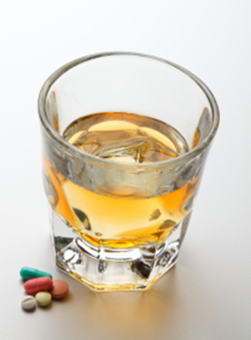
DEADLY MIX
Nearly all unintentional drug overdose deaths in NYC (98%) involve more than one substance, including alcohol.
Opioids were the most commonly noted drug type(74%). Types of opioids included heroin, methadone and prescription pain relievers.

Slide 7

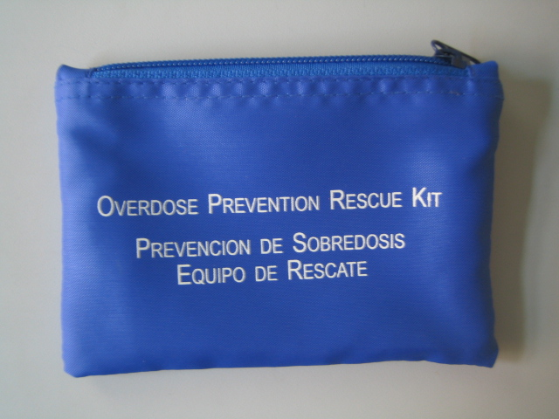
Responding to an opioid overdose using naloxone

Slide 8
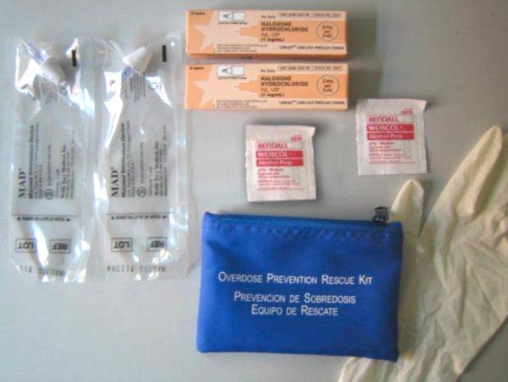
INTRANASAL (IN) NALOXONE
2 needle-less syringes
2 pre-filled vials of naloxone
2 nasal atomizers
2 latex gloves
2 Alcohol Swabs

Slide 9
NALOXONE’S EFFECTS
Usually acts within 2-5 minutes
If the person was opioid dependent, naloxone may put them into withdrawal
Naloxone blocks the effects of all opioids
Naloxone lasts for 30-90 minutes
Harmless/no effects if the person had no opioids in their system
Will not reverse overdoses caused by substances that are not opioids (cocaine, alcohol, benzodiazepines, methamphetamine)

Slide 10
THE NALOXONE PROGRAM IS ALREADY A SUCCESS
THERE HAVE BEEN FOUR USES OF NALOXONE BY PATROL OFFICERS IN THE 120 PCT.
TWO PATIENTS WERE IMMEDIATELY REVIVED
NALOXONE HAD NO APPARENT EFFECTS IN THE OTHER TWO CASES

Slide 11

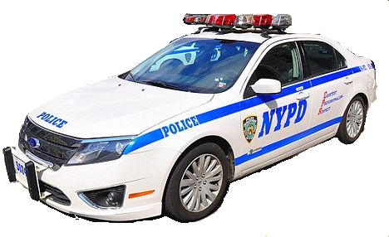
RESPONDING TO AN OVERDOSE
    Ensure that EMS is Responding
    Check Patient Responsiveness
      Shoulder Tap
      Shoulder Shake
      Sternum Rub
    Check for Breathing
      Look for chest movement
      Listen for exhale
      Feel for air exchange

Slide 12
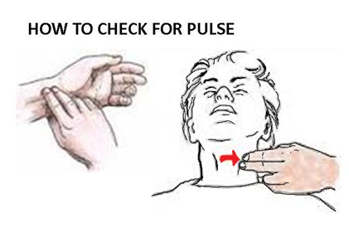
ADMINISTER CPR IF NECESSARY
Check For Pulse: Be sure to use the index and middle finger when checking for a pulse.
If no pulse and NOT Breathing-
Open The Airway
Administer 30 Chest Compressions
Comply with Patrol Guide 216-19, “Public Access Defibrillation Program”

Slide 13
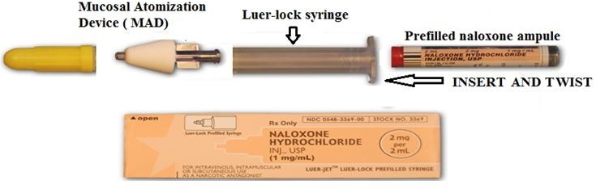
ADMINISTER NALOXONE
Assemble your naloxone dose.
  Affix the nasal atomizer (applicator) to the needleless syringe.
  Place the glass cartridge of Naloxone within the syringe.

Slide 14
Assemble your naloxone dose.
  Affix the nasal atomizer (applicator) to the needleless syringe.
  Place the glass cartridge of Naloxone within the syringe.
Tilt victim’s head back.
Spray half of the vial up the nostril. Spray the remainder of the vial up the other nostril. Spray until all of the liquid has been expelled.
If no response in 2-5 minutes, administer the 2nd naloxone vial.

Slide 15
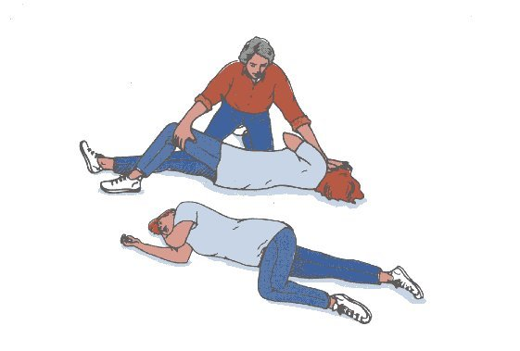
RECOVERY POSITION
If you must leave the victim even for a few minutes, put them into the recovery position so they won’t choke on vomit

Slide 16
REPLACE YOUR NALOXONE
Get a refill of Naloxone
    Even if just one dose was used
    If kit is lost or damaged
    If Naloxone is nearing expiration date (every 2 years)
Store naloxone at room temperature and away from direct light
Discard used vial of Naloxone in trash
Notes:
Two doses are not for 2 overdoses but in case the first one is not enough

Slide 17
REPORTING REQUIREMENTS
Report use of Naloxone
    Aided Report Worksheet (PD 304-152b) in non-arrest situations or
    Medical Treatment of Prisoner Form (PD 244-150) in arrest situations
    Fax all reports to OMAP (646-610-5932)
    Submit reports to Desk Officer
NOTE: Include location, type of substances used if known, condition of aided, if CPR was administered and if victim survived.
Notes:
Two doses are not for 2 overdoses but in case the first one is not enough

Slide 18
Maintain Your Skills
Receive Refresher Training every year.
Every so often, take out your kit, review instructions, and practice assembling your Naloxone dose quickly.
Notes:
Two doses are not for 2 overdoses but in case the first one is not enough

Slide 19


QUESTIONS?

